Slide 1
EGI Federated Cloud for Open Science
Diego Scardaci (EGI.eu), Fotis Psomopoulos (AUTH), Kimmo Mattila (CSC)
diego.scardaci@egi.eu, fpsom@issel.ee.auth.gr, kimmo.mattila@csc.fi
http://go.egi.eu/cloud

Slide 2
Training goals
Learn the concept of IaaS cloud computing
Learn the conceptual model of the EGI federated cloud
Obtain skills in using the standard interfaces of the EGI federated cloud
With pre-defined Virtual Machine images
With customised deployments (contextualisation)
With Docker containers
(With your own images)
Learn how to deploy bioinformatic applications in the EGI federated cloud
Learn how to become an active user
Learn how to book the EGI training infrastructure for your tutorials

Slide 3
Outline
Introduction to EGI, & EGI Federated Cloud (20’)
Introduction to training infrastructure (10’)
Exercise 1 (60’): Run Chipster in the EGI Federated Cloud
BREAK (15’)
Exercise 2&3 (45’)
Compute management – Setup a Jupyter Notebook
Persistent storage – Add block storage to the Jupyter Notebook
Introduction to contextualisation (10’)
Exercise 4: Contextualised compute service – Fractal application (Home Work)
Introduction to Docker (5’)
Exercise 5: Running a Galaxy Docker container in the EGI Cloud (30’)
Prepare your VM images and next steps (10’)
Feedback forms (5’)
Notes:
TODOs:

Slide 4
Introduction to EGI & EGI Federated Cloud

Slide 5
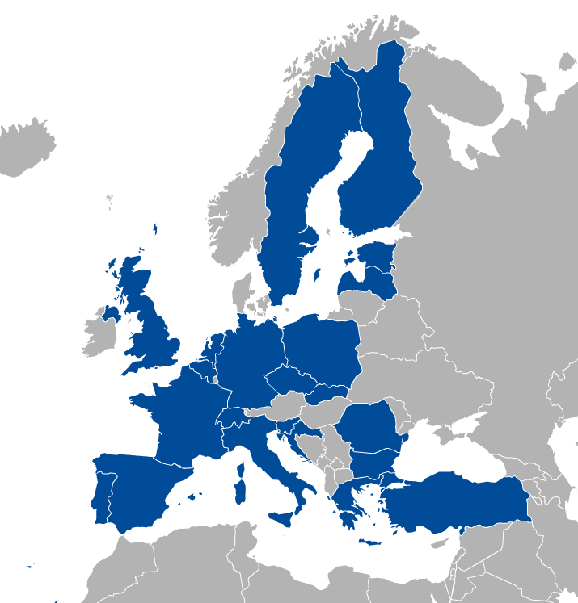
EGI (European Grid Infrastructure)
EGI Council
26 participants: 22 NGIs and 2 EIROs (CERN, EBI)
Opening membership to research communities
Affiliation programme for countries
Shared interest in
Developing and providing e-infrastructure services that enable open science
Sustainability
Sustainable core services (HW, SW, human!)
Project-driven innovation
H2020: EGI-Engage, AARC, INDIGO-Datacloud, ELI-Trans, etc.
EGI.eu in Amsterdam
Membership under discussion
Armenia, Austria, Belarus, Denmark, Ireland, Moldova, Norway, Russia, Ukraine
Notes:
E-Infrastructures are geographically distributed computing resources and data storage facilities linked by high-performance networks. They allow scientists to share information securely, analyse data efficiently and collaborate with colleagues worldwide. They are an essential part of modern scientific research and a driver for economic growth.
EGI was established in 2010 building on over a decade of investment by national governments and the European Commission. EGI is a European-wide federation of national computing and data storage resources. Its aim is to support cutting-edge research, innovation and knowledge transfer in Europe. EGI federates resources from various resource centres, mainly from research insitututes and universities. These centres provide computer clusters, storage servers, applications and human support services for secure access and sharing. EGI provides these services to European researchers and their international collaborators.
EGI is coordinated by EGI.eu, a not-for-profit foundation based in Amsterdam and owned by EGI’s participants, the National Grid Infrastructures (NGIs).

Slide 6
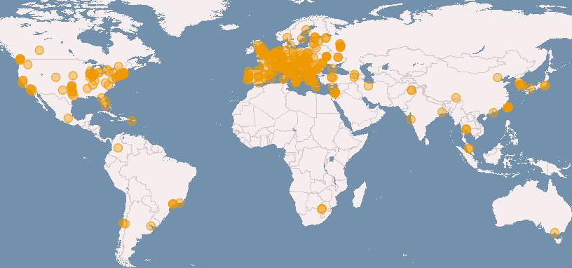








‘Enabling Global Infrastructures’
Community SLAs Provider OLAs
Distributed, federated storage and compute facilities
Compute platforms (Grid, Cloud)
Virtual Research Environments
> 200 user research projects
Total capacity:
340 resource centres in 54 countries
550,000 logical CPU cores
290 PB disk, 180 PB tape
.
.
.
Notes:
SLA – Service Level Agreement
OLA – Operation Level Agreement

Slide 7
Cloud computing & Key terms
Services and solutions delivered and consumed in real time over the Internet
(Some of the) benefits
Virtualisation – Platform-independence; Self-servicing
Scalability – ‘Pay-as-you-go’; Multi-tenant allocation
Predictability – Versioning of VMs and contextualisation scripts
Abstractions – IaaS, PaaS, SaaS
Open source – KVM, OpenStack, OpenNebula, …
VM image
App
App
App
Storage volume
Software Appliance
Virtual Appliance
OS
VM image
Meta data
Cloud management framework
Contextualisation script
Hardware
Virtualized Stack

Slide 8
What is a cloud federation? – A ‘definition’
Practice of interconnecting cloud service providers. Motivations:
Data locality; Data privacy; Shared investment; Distributed expertise, …
Multiple cloud sites with some sort of interconnection(s). Examples:
Every cloud registered in a single catalogue
Single VM image catalogue for users
Support for the same image format
Automated distribution of VM Images to the federated clouds
Single sign-on for users
Harmonised operational practices
Cloud configurations, integrated monitoring, accounting, etc.
Integrated support model
Ticketing system, consultancy, training
EGI Federated Cloud can do all this

Slide 9
EGI Federated Cloud
Grid of clouds
Unified user interfaces
Harmonised operational behaviour
Clouds and their interconnections are based on open standards, open technologies
Infrastructure → Access AND technology → Deploy

Slide 10



Benefits
TOPIC OF THIS TUTORIAL
- On every site
OpenStack Nova
- On OS sites
Uniform user interfaces
Harmonised operation
OpenStack
OpenNebula
Cloud registry
Information system
Virt. Machine marketpl.
Usage accounting
Access control
Synnefo
OpenStack
OpenNebula
OpenStack

Slide 11


Inside a cloud site – Technical slide
OpenStack Nova
Manage instances
Uniform interfaces and behaviour
Share & endorse VM images (OVF)
Cloud Site
(OpenStack)
Cloud Site
(OpenNebula)
Cloud Site
(Synnefo)
Image replication (VMCatcher)
Cloud Providers
Virtual Appliances Catalog (AppDB)
VM image in the VO image list
Service registry (GOCDB)
Information system (BDII)
Accounting (APEL)
Monitoring (ARGO)
AAI (PERUN)
Operation services
EGI e-infrastructure operation tools

Slide 12

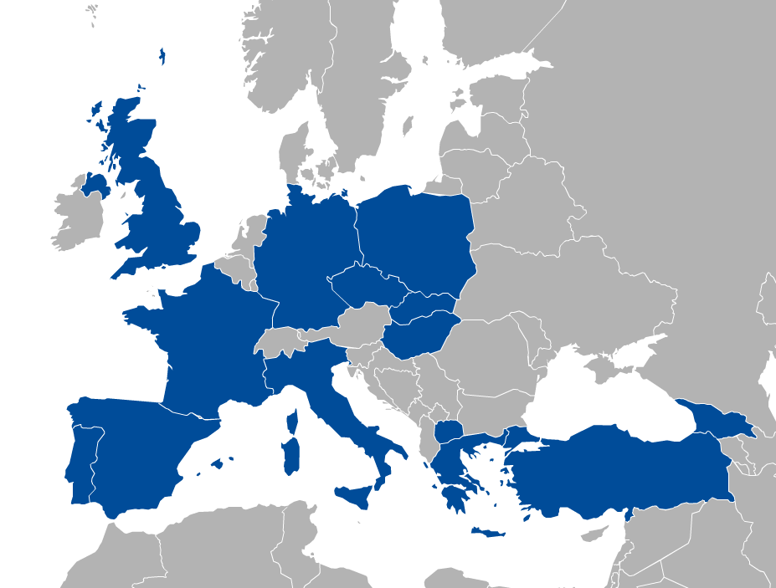















The current infrastructure
Today:
22 providers from 14 NGIs
15 OpenStack
6 OpenNebula
1 Synnefo
~6.000 cores in total

Slide 13
Access to the Federated Cloud: Virtual Organisations
VO 1 (cloud a, b, c)
VO 2 (cloud b, c, d, e)
VO membership and resource access with X.509 certificates
Generic VOs – e.g. fedcloud.egi.eu → Incubator for new users
Community-specific VOs – e.g. CHIPSTER, Highthroughtputseq, EISCAT, etc. (SLA, OLAs)
Training VO = training.egi.eu → To be used today
Browse VOs at http://operations-portal.egi.eu/vo/search (both grid and cloud)

Slide 14
The typical user workflow
Exercises today
Exercises today
Clouds in your Virtual Organisation (e.g. training.egi.eu)
Application Portal, framework, SaaS, etc..
Visual lookup
OCCI or Nova calls (CMD/API)
VM
VM
VM
OCCI or Nova calls (CMD/API)
VM
VM
VM
Programmatic lookup (API)
VM
Storage
Appliances Marketplace (AppDB)
VM
Virtual/Software Appliances of your Virtual Organisation
VM
VM
VM
VM
VM
VM
VM
VM
VM
Notes:
Remark: The Virtual Appliances Catalogue does not store physically the VMs. It stores only references and metadata about the VMs. The VMs are physically stored elsewhere – e.g. third party HTTP server, EGI Repository

Slide 15
Typical usage models
Compute and data intensive workloads
Batch and interactive (e.g. iPython-Jupiter) with scalable and customized environments
Service Hosting
Long-running services (e.g. web server, database, application server, Galaxy server)
Datasets repository
Store and manage large datasets (in a storage volume)
Disposable and testing environments
Host training environments, test applications

Slide 16

Combined models
Combine usage models in a single application
Scalable Service hosting
Block Storage RAID
Exercise 2
Exercise 3
Web
Server
Data
Server
attach
End User
spawns
Exercise 4
mount
Worker
Worker
Worker
analyse
data
Scalable Compute and data processing
Object Storage*
* Object storage (CDMI or other) is not available on every site

Slide 17
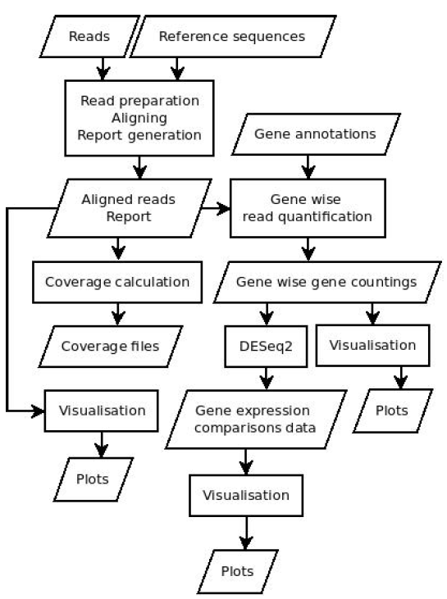

Example: READemption
Pipeline for the computational evaluation of RNA-Seq. data
Usage Model
Heavy computation
Scientific Disciplines
Bioinformatics
Large Memory
Deployment in the FedCloud
VMs with 24 cores, 128 GB of RAM
Block storage up to 3 TB
Source: Konrad U. Förstner

Slide 18
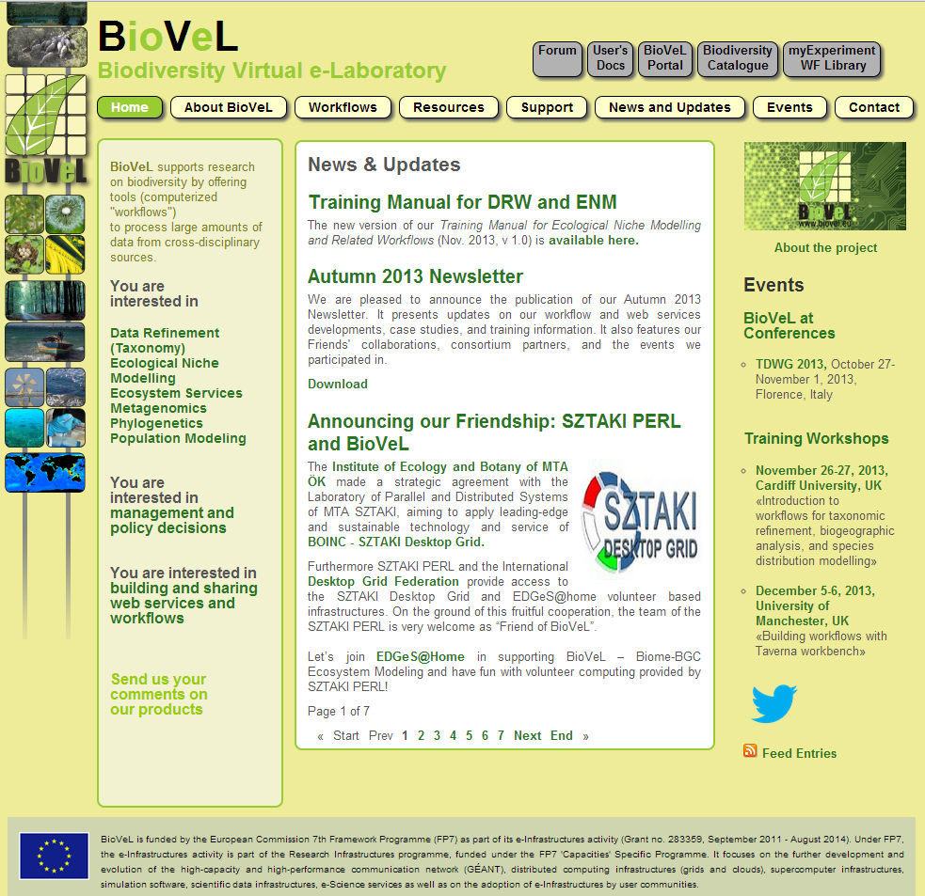
BioVEL
Workflows:
Data Refinement Workflow
Ecological Niche Modeling Workflow
Ecosystem Services
Metagenomics
Phylogenetics
Population Modeling Workflow

Slide 19
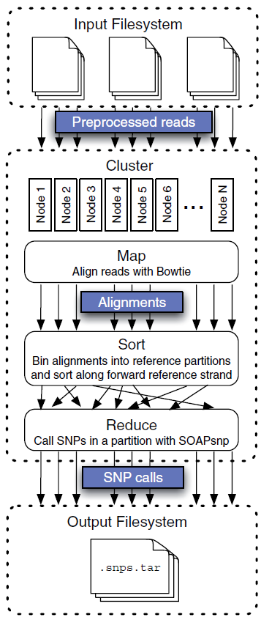
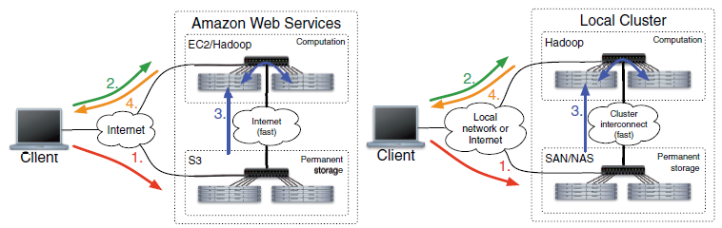
Crossbow
Identifies SNPs from high-coverage, short-read resequencing data
Combines the Aligner Bowtie and the SNP caller SOAPsnp
Hadoop MapReduce approach
Amazon EC2 / Local Cluster
Notes:
Talk briefly about hadoop
Arcitecture, object storage, compute nodes etcs

Slide 20
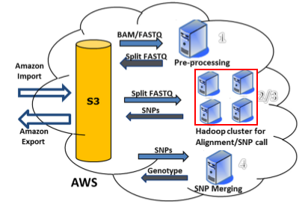
Rainbow
Large scale Whole Genome Sequencing (WGS) analysis
Supports FASTQ and BAM input
Load balancing
Active workflow monitoring
Amazon EC2
Notes:
Talk briefly about hadoop
Arcitecture, object storage, compute nodes etcs

Slide 21
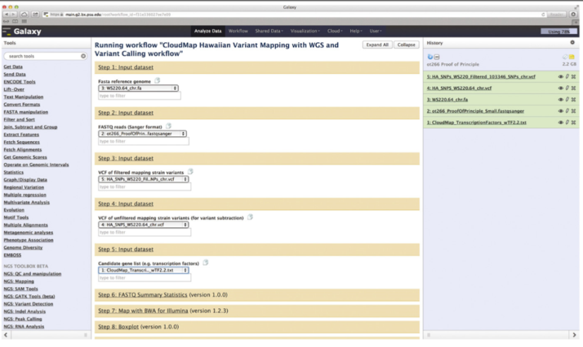
CloudMap
Greatly simplifies the analysis of mutant whole genome sequences
Offers predefined workflows to pinpoint variations in animal genomes
Available on the Galaxy web platform
Amazon EC2 / Local Cluster
Notes:
Talk briefly about hadoop
Arcitecture, object storage, compute nodes etcs

Slide 22
CloudBurst
Parallel read-mapping algorithm optimized for mapping NGS data to the human and other reference genomes
Modeled after the short read-mapping RMAP program
Parallelization overcomes computational barriers and allows deeper analysis
Hadoop MapReduce approach
Almost linear increase in performance to the number of CPU cores available
Notes:
Talk briefly about hadoop
Arcitecture, object storage, compute nodes etcs

Slide 23
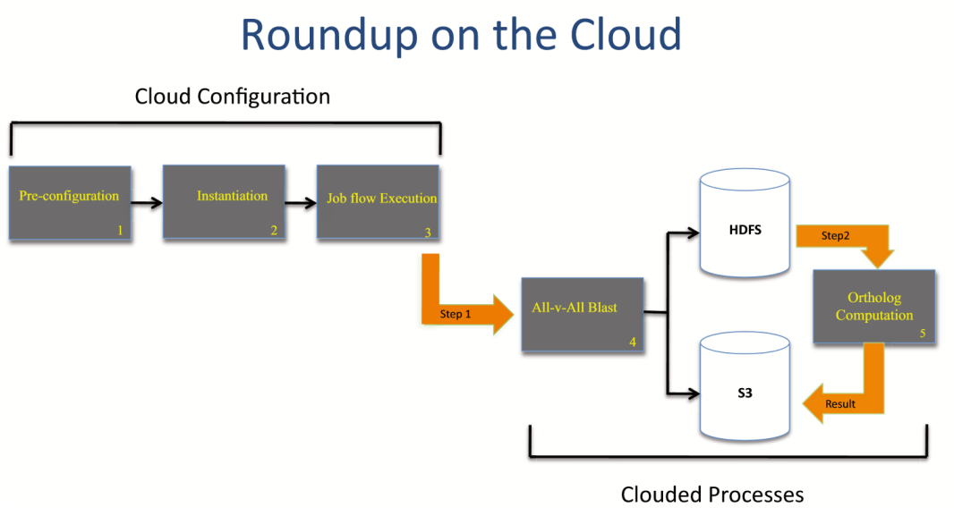
RSD-Cloud
Large comparative genomics analysis tool
Redesigned the reciprocal smallest distance algorithm (RSD) to run on a cloud computing environment
Fast and cost efficient solution
Amazon EC2
Notes:
Talk briefly about hadoop
Arcitecture, object storage, compute nodes etcs

Slide 24
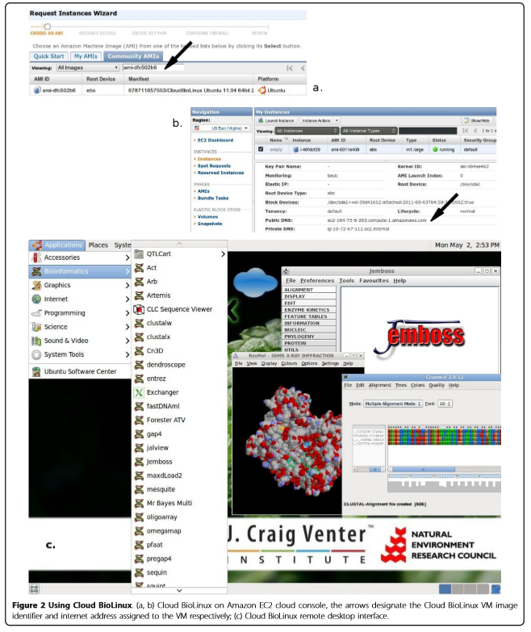
Cloud BioLinux
Publicly accessible VM
Platform for developing bioinformatics infrastructures on the cloud
Quick provision of on-demand infrastructures for HPC in bioinformatics
Pre-configured tools and GUI
Tested on Amazon EC2, Eucalyptus, Okeanos and Virtual box

Slide 25
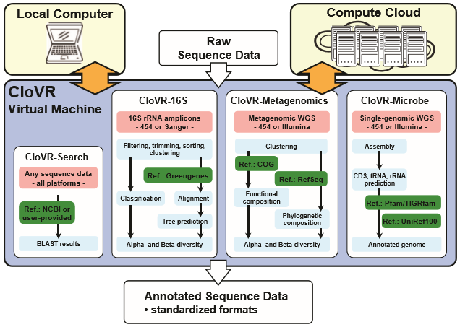
CloVR
Portable VM
Several automated analysis pipelines for microbial genomics provided, including 16S, whole genome and metagenome sequence analysis
Run on a local PC but also supports use of remote cloud computing resources on multiple cloud computing platforms.

Slide 26
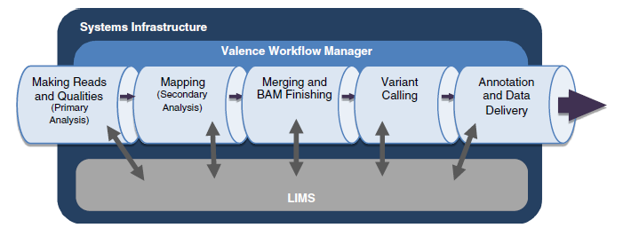
Mercury
Integration of multiple sequence analysis tool in a single DNAnexus based platform
Simplified workflow construction GUI
Applet based workflows
Amazon EC2 / Local Cluster

Slide 27
Taverna
General purpose open source and domain-independent Workflow Management System
Combines distributed web services and local tools into complex analysis pipelines.
Execution takes place either locally or in a grid or cloud environment using the Taverna server
Widely adopted in bioinformatics workflows, typically in the areas of high throughput omics analyses like proteomics, transcriptomics and evidence gathering methods involving text or data mining.

Slide 28
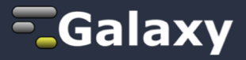
Galaxy
Offers genome analysis resources for cloud computing platforms
Amazon EC2
Virtual Box
Eucalyptus
Okeanos
Freely available and community maintained
software images and
data repositories
Widely adopted in the bioinformatics community

Slide 29
Tavaxy
Stand alone pattern based workflow system
Integrates the use of Taverna and Galaxy workflows in a single environment
Hierarchical workflows and workflow patterns approach
Utilization of local and cloud HPC resources
Currently centered on sequence analysis. Transcriptomics and proteomics analyses in development.

Slide 30
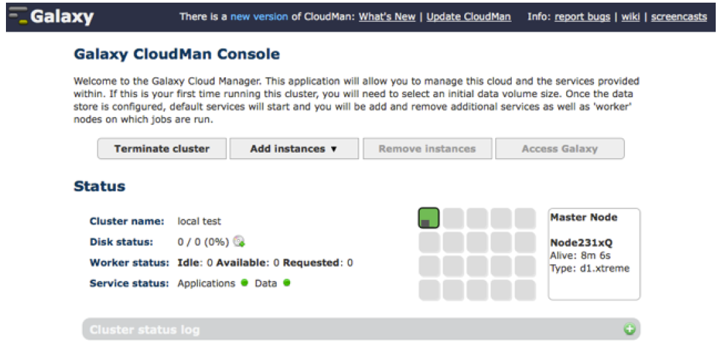
CloudMan
Custom deployment of cloud resources
Browser creation and control of an arbitrarily sized compute cluster on Amazon EC2
Minimal informatics experience required for use
Large number of tools available, packaged by the NERC Bio-Linux team.
Based on Galaxy

Slide 31
High Level Tools (PaaS & SaaS)
Today we focus on IaaS with OCCI (rOCCI cmd. line), but…
Higher level tools exist on top of this
Alternatives to OCCI and Nova– but usually much more!
External contributions – EGI is open for additional tools! Suggest/integrate!
Currently:
Others are emerging:
Occopus orchestrator
Karamel platform
D4Science environment
…
VMDIRAC
WS-PGRADE
Vcycle
Catania Science Gateway
Slipstream
COMPSs
https://wiki.egi.eu/wiki/HOWTO10.

Slide 32
Training infrastructure

Slide 33
training.egi.eu Virtual Organisation
Site | Available capacity in the VO
CESNET (CZ) | 64 vCPUs 110 GB of RAM 1 TB of persistent storage
BIFI (ES) | 50 vCPUs 50 GB of RAM 50 storage volumes 50 public IP addresses
UKIM (MK) | 48 vCPUs 48 GB of RAM 48 public IP addresses
CETA-CIEMAT (ES) | 20 vCPUs 40 GB of RAM 5.4 TB storage 10 public IP addresses
INFN (IT) | 20 vCPUs 50 GB of RAM 1 TB storage 10 public IP addresses
CESNET (OpenNebula)
UI
BIFI (OpenStack)
UKIM (OpenNebula)
CETA-CIEMAT (OpenStack)
INFN (OpenStack)
Trainers join VO with X.509 personal certificates → Generate own proxy for access
Trainees get proxies from trainers. Your proxy is valid for 24 hours
You will need personal certificate from a recognised CA for the long-term – More later!

Slide 34

Accessing the training VO
1 account / trainee
1 proxy / account
Ubuntu 14.04 with rOCCI client
Configured by trainers
Login with SSH
UI
OCCI commands
Get IDs of
Cloud endpoint
VA image
Resource template
Access (e.g. SSH, Web)
VM
Block storage
VM Marketplace (AppDB)
http://appdb.egi.eu → Cloud Marketplace
Training.egi.eu VO

Slide 35
OCCI and rOCCI
OCCI (Open Cloud Computing Interface, OGF, 2011)
For VM Management (compute and storage)
Text-based protocol and API focusing on cloud interoperability
rOCCI (OCCI command-line client; r for Ruby)
To be used today
Interacts with the OCCI servers deployed on cloud sites
Supports EGI AAI (X.509 certificates + VOMS)
Available with installer, as VM image, as Docker container or source
jOCCI: Java API for OCCI
Further info: https://wiki.egi.eu/wiki/Federated_Cloud_APIs_and_SDKs

Slide 36
Main commands to be used during Exercises
Command | Explanation
voms-proxy-info | Check the lifetime of your proxy
ssh-keygen | Generate key-pairs for password-less SSH
occi --endpoint A --auth B --action C –resource D | Perform action C on resource D of cloud site A authenticating as B
--action list
--action create
--action describe
--resource compute
--resource storage
cloud site
X.509 proxy
rOCCI quick reference guide: https://gist.github.com/arax/4de4a41fb0fa67719856

Slide 37
Log into the UI
Log into the User Interface
SSH to 147.228.242.12
Username: xxxx
Password: xxxx
Check your proxy file
Check the lifetime of your credential
~$ echo $X509_USER_PROXY
~$ voms-proxy-info –all

Slide 38
Get ready to access your VMs with SSH
VMs are (normally) accessible through SSH
But password logins are disabled
Instead use key pairs
Create a ssh key to access:
(defaults are ok, can be left without password for the tutorial)
~$ ssh-keygen

Slide 39
Excercise 1
Running Chipster in EGI Federated Cloud

Slide 40
Chipster: http://chipster.csc.fi
Open source platform for data analysis
Provides an easy access to over 340 analysis tools
No programming or command line experience required
What can I do with Chipster?
analyze and integrate high-throughput data
visualize data efficiently
share analysis sessions
save and share automatic workflows

Slide 41
Analysis tools
140 NGS tools for
RNA-seq
miRNA-seq
exome/genome-seq
ChIP-seq
FAIRE-seq
MeDIP-seq
CNA-seq
Metagenomics (16S rRNA)
60 tools for sequence analysis
BLAST, EMBOSS, MAFFT, Phylip
140 microarray tools for
gene expression
miRNA expression
protein expression
aCGH
SNP
integration of different data
Notes:
TODOs:
41

Slide 42
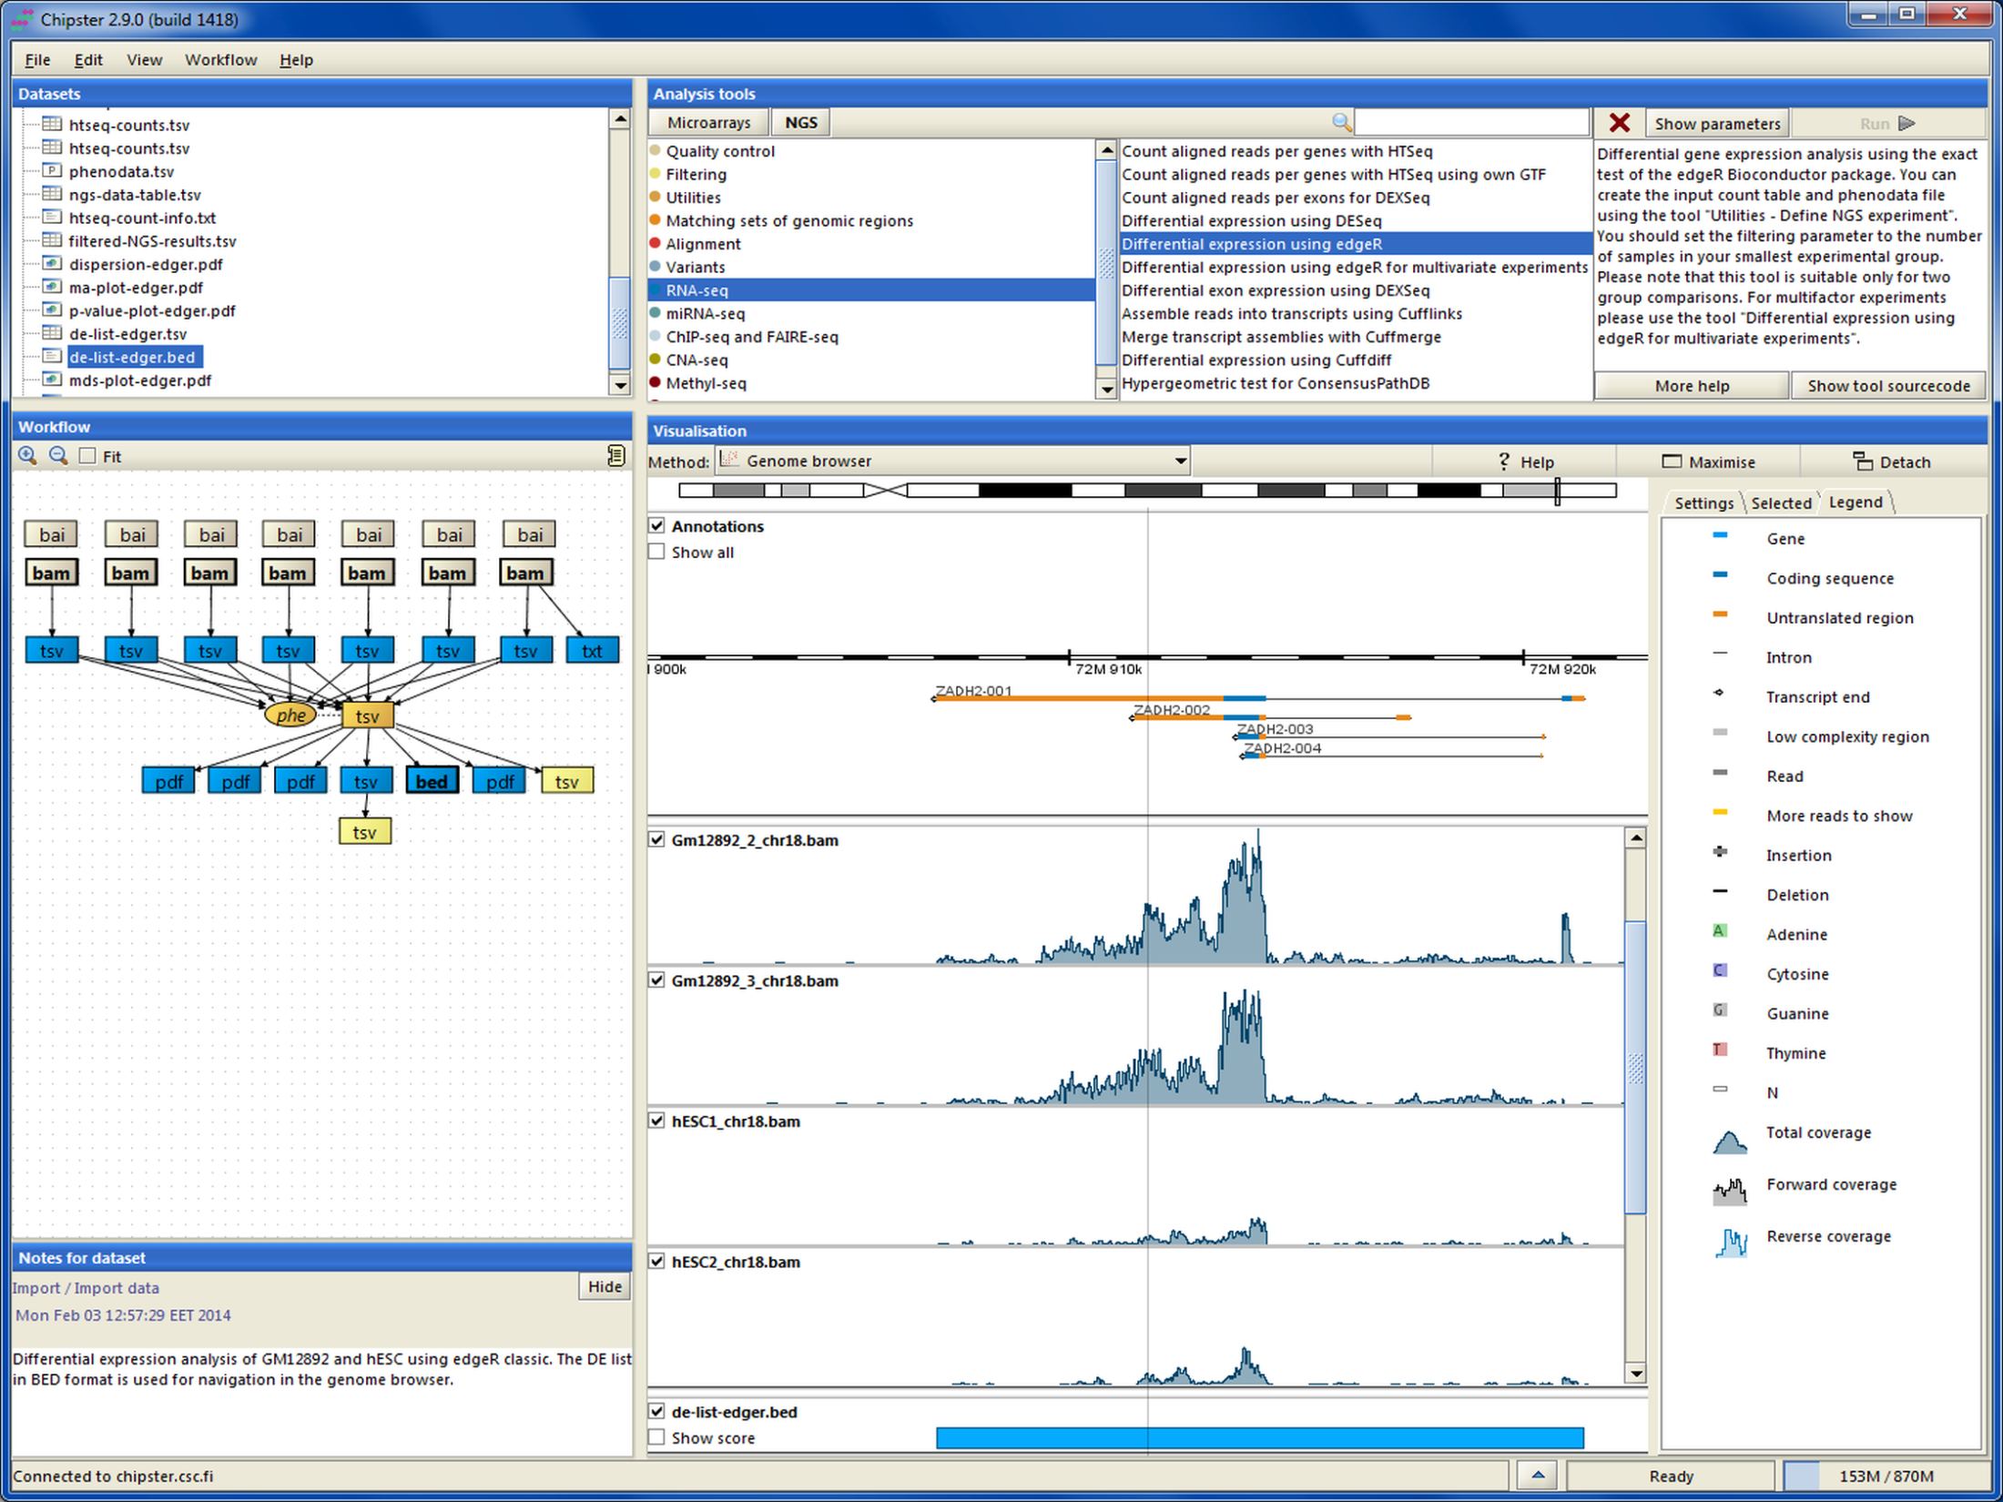
Chipster client

Slide 43
Chipster
Chipster id free, open source software
CSC hosts a Chipster server for researchers working in Finland
If you are not working in Finland you must purchase account to CSC or use some other Chipster server
Notes:
43

Slide 44


Chipster in EGI Federated Cloud
EGI Federated Cloud
Chipster VM
Web browser
( Chipster client+ JavaWS)
Chipster
server
Users
Data
OCCI
SSH
CVMFS mount
Tools
(200 GB)
Tools needed:
- Certificate
- VO membership
- rOCCI
- Mac OSX or Linux
Local Chipster
manager
Notes:
Remark: The Virtual Appliances Catalogue does not store physically the VMs. It stores only references and metadata about the VMs. The VMs are physically stored elsewhere – e.g. third party HTTP server, EGI Repository
44

Slide 45
Launching Chipster in EGI Federated cloud
Create a contextualization script that contains commands to create the required directories and CVMFS linking ( about 50 lines)
Create a data volume
Select VM-flavor and operating system template and launch the virtual machine
Set a public IP address
Connect to the new VM and restart chipster server

Slide 46
Launching Chipster in EGI Federated cloud
... or use FedCloud_chipster_manager
./FedCloud_chipster_manager -launch -key your_cloud_key
Tasks available in FedCloud_chipster_manager
launch a chipster server
delete a chipster server
list chipster servers in current VO
check status of chipster servers in current VO
restart a Chipster server
add chipster user accounts to the server

Slide 47
Using Chipster in EGI Federated Cloud
When the server is running, end users can access the server using port 8081
https://[ip.address.of.the.VM]:/8081
The manager of the server can open a terminal connetion to the server:
ssh -i keyfile ubuntu@[ip.address.of.the.VM]
Instructions for managing your Chipster server can be found from the Chipster technical manual:
https://github.com/chipster/chipster/wiki/TechnicalManual

Slide 48
BREAK

Slide 49
Exercise 2 & 3: Jupyter Notebook

Slide 50



Jupyter Notebook
Open source, interactive data science and scientific computing across over 40 programming languages.
Notebooks can be shared with others using email, Dropbox, GitHub
Interactive widgets
Favorite tool for the Software and Data Carpentry workshops

Slide 51
Exercise 2 and 3
Managing VMs and block storage:
Start a Jupyter Notebook on an EGI Cloud site
Use persistent storage for Jupyter files

Slide 52
Exercise 2: Run a Jupyter Notebook in the EGI Federated Cloud

Slide 53
Exercise 1: Jupyter Notebook setup
What you have to do:
Browse AppDB, find 3 IDs (visual lookup):
ID of the cloud site you want to use
ID of the Jupyter Notebook VM image for that site
ID of the resource template the VM should use (smallest!)
Create VM instance (OCCI call)
Access wiki from a web browser

Slide 54
Browsing AppDB
DEMO
Go to AppDB:
http://appdb.egi.eu
Cloud Mp → Virtual Organizations → training.egi.eu
Choose Jupiter Notebook VA and a specific site
See request on next slide!
VAs and SAs in this VO:
Baseline OS appliances
Minimal OS images
Centos6, Ubuntu 12.04, Ubuntu 14.04
Specific appliances
FedCloud tools: Ubuntu 14.04 with FedCloud clients ready to use
MoinMoin wiki: Ubuntu 14.04 image with MoinMoin installed and configured to run on startup
Jupyter Notebook: Centos6 image with Jupyter Notebook installed
Software appliances
Use contextualization to deliver the functionality

Slide 55
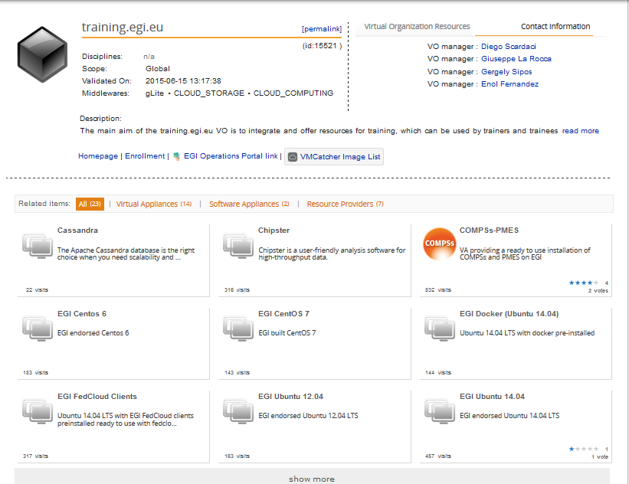
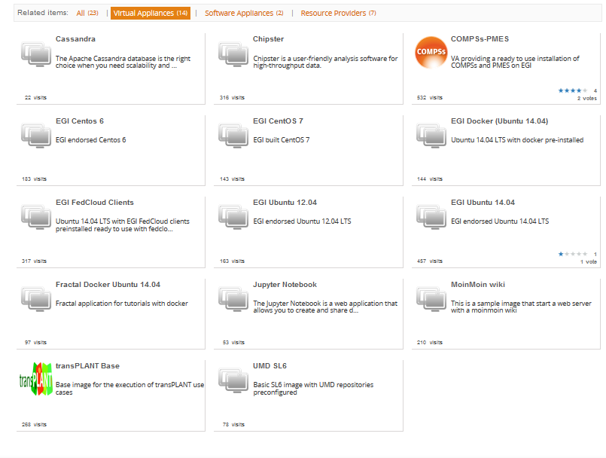
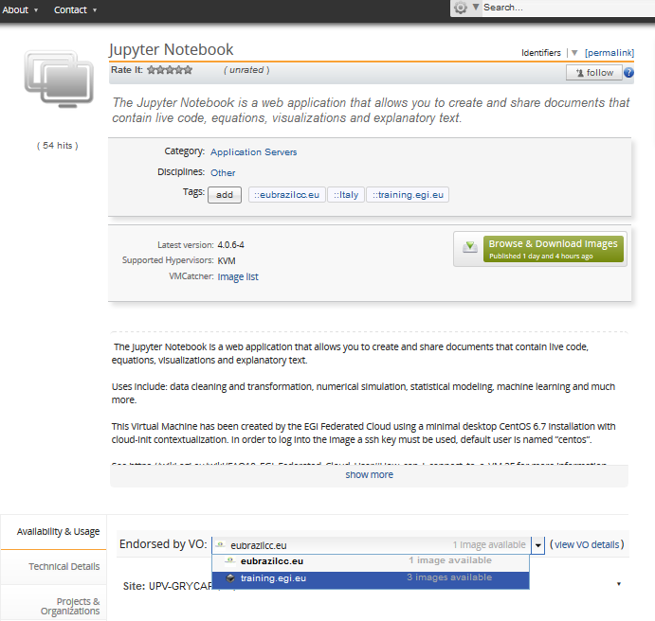
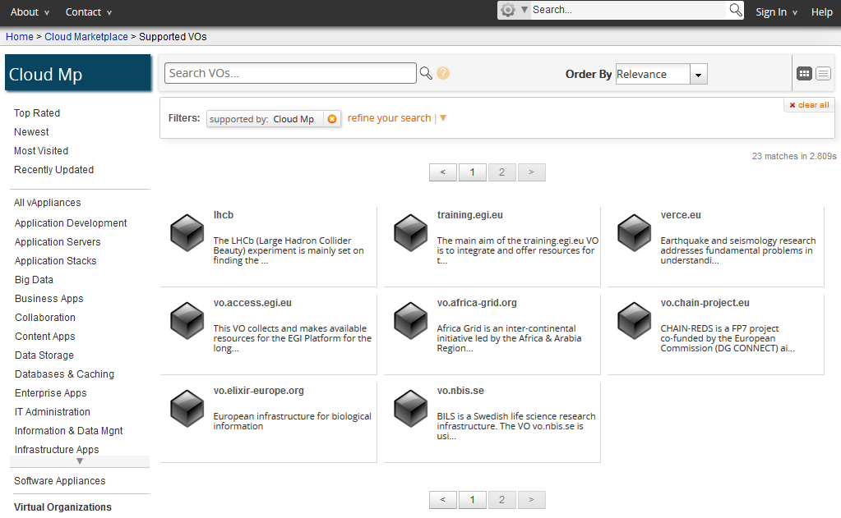
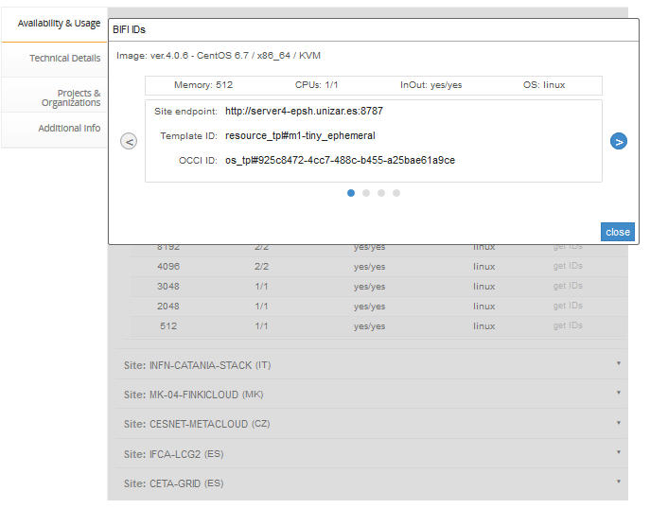
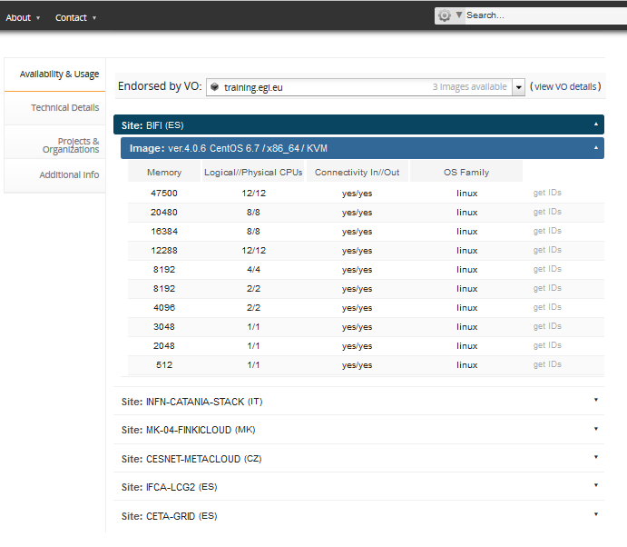
Which cloud
In which size
Which image

Slide 56
REQUEST
Instantiate VMs based on the smallest resource templates during the whole tutorial
I.e. Use the following Template IDs:
Site | Template name | Template ID
CESNET | Small | http://schema.fedcloud.egi.eu/occi/infrastructure/resource_tpl#small
BIFI | Tiny | resource_tpl#m1-tiny-ephemeral MORE COMPLEX NETWORKING!
INFN-CATANIA-STACK | Small | resource_tpl#m1-small

Slide 57
Create your first compute appliance
Use MoinMoinWiki VA values from AppDB!
~$ ENDPOINT=<Copy here Site Endpoint information from AppDB>
~$ RESOURCE_TPL=<copy here the Template ID from AppDB>
~$ OS_TPL=<copy here the OCCI ID from AppDB>
~$ occi --endpoint $ENDPOINT \
--auth x509 --voms --user-cred $X509_USER_PROXY \
--action create --resource compute \
--mixin $RESOURCE_TPL --mixin $OS_TPL \
--attribute occi.core.title=“notebook$(date +%s)" \
--context public_key="file:///$HOME/.ssh/id_rsa.pub"
~$ COMPUTE_ID=...
Save the ID in an Env. variable

Slide 58
List and describe your VM instances
~$ occi --endpoint $ENDPOINT \
--auth x509 --voms --user-cred $X509_USER_PROXY \
--action list --resource compute
~$ occi --endpoint $ENDPOINT \
--auth x509 --voms --user-cred $X509_USER_PROXY \
--action describe --resource $COMPUTE_ID
This returns lot of info, including the IP Address of your VM!
occi.networkinterface.address = …
→ It’s not so simple ☹ See next slide!

Slide 59
Accessing the appliance
If the VM does not have a public IP (on BIFI endpoint):
~$ occi --endpoint $ENDPOINT \
--auth x509 --voms --user-cred $X509_USER_PROXY \
--action link --resource $COMPUTE_ID \
--link /network/public
Obtain the IP address from the output of the describe command.

Slide 60
Logging into the appliance
ssh with centos user:
~$ ssh centos@<your vm ip>
Once logged in, check the size of the image:
~wiki $ cat /proc/cpuinfo
~wiki $ cat /proc/meminfo

Slide 61
Start the service
After connecting to the newly launched VM, start the Jupyter notebook as follows:
Jupyter start a web-server (by default listening to port 8888)
Go to your web-browser and type:
https://[public ip]:8888
~$ jupyter notebook

Slide 62
Transfer files
We can transfer input/data files, as well as notebooks from any given location to the current VM.
In our case, let’s take some sample files using wget as follows:
“Real-world” notebook
~$ wget http://grid.ct.infn.it/cron_files/ELIXIR_WS/GeneExpressionHeatmap.ipynb
~$ wget http://grid.ct.infn.it/cron_files/ELIXIR_WS/Data_Cortex_Nuclear.csv
~$ wget http://grid.ct.infn.it/cron_files/ELIXIR_WS/SraRunTable.txt
Corresponding dataset
A dataset for our exercise now

Slide 63
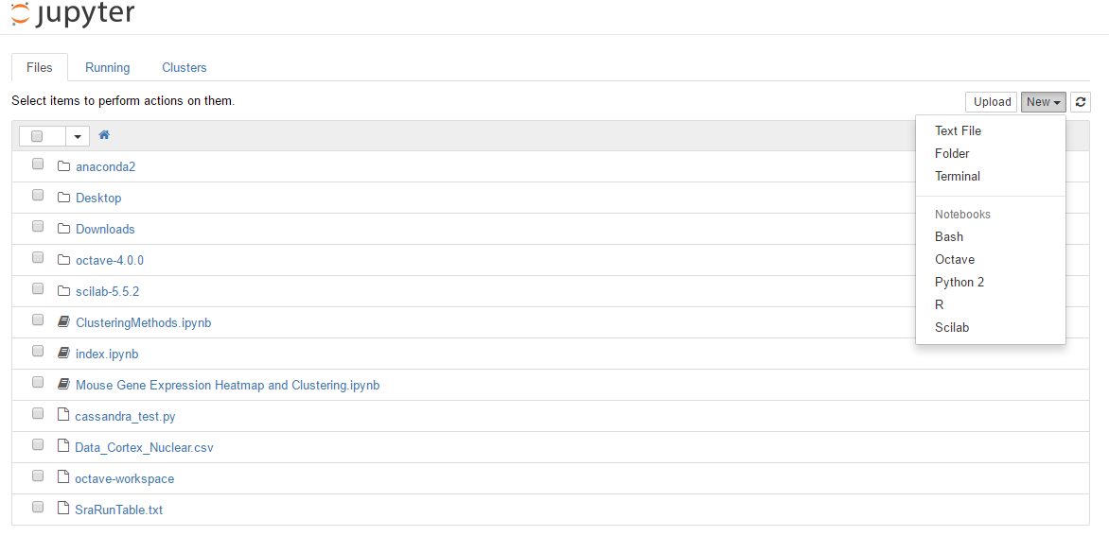
Jupyter’s main page
Select the R kernel for our case

Slide 64
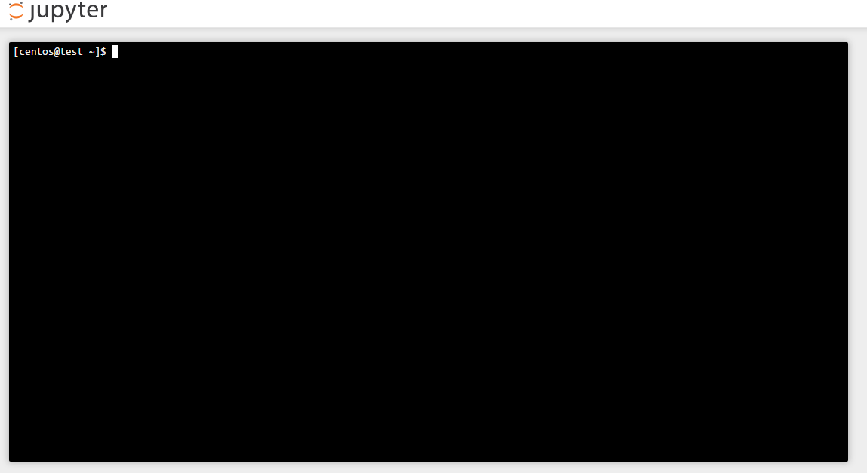
You can also have a terminal case
Useful for basic CLI training.

Slide 65
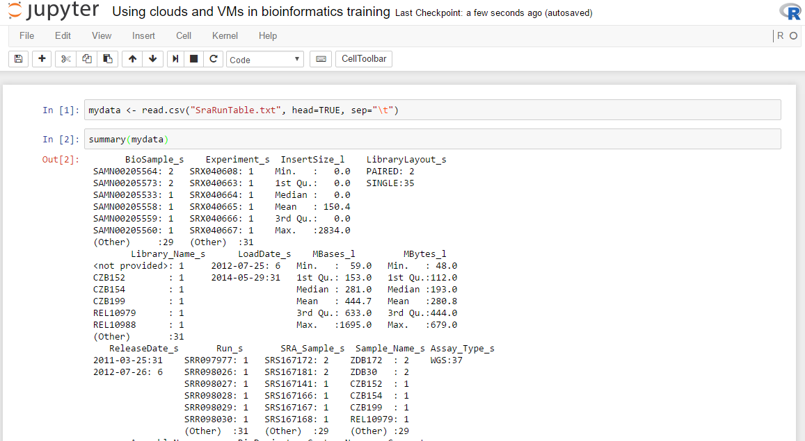
We can show standard downsteam analysis
Each R command is executed within the VM
Results are shown on page

Slide 66
Example case
Let’s run the following commands in the newly created (adapted from the Data Carpentry genomics lesson)
~$ sradata <- read.csv("SraRunTable.txt", head=TRUE,
sep="\t")
~$ summary(sradata)
~$ install.packages("dplyr",
repos='http://cran.us.r-project.org')
~$ library("dplyr")
~$ select(sradata, LibraryLayout_s, LoadDate_s, MBases_l,
Sample_Name_s)
~$ filter(sradata, LibraryLayout_s == "PAIRED")
~$ sradata %>%
select(LibraryLayout_s, LoadDate_s, MBases_l,
Sample_Name_s) %>%
filter(LibraryLayout_s == "PAIRED")
Load data in the notebook

Slide 67
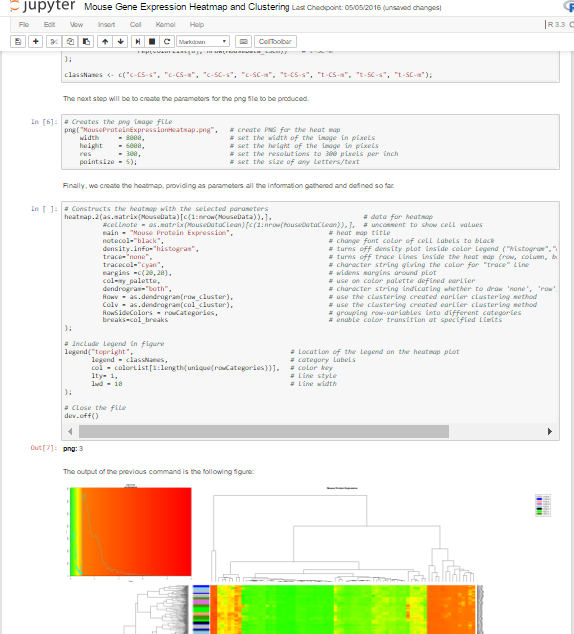
Run entire preset notebooks
One of the key advantages is to allow the re-use of defined notebooks
Open the “Mouse Gene Expression Heatmap and Clustering” notebook
It’s an entire process, with documentation, that can allow specific tasks (the creation of a Gene Expression heatmap in this case)

Slide 68
Exercise 3: Jupyter with persistent storage

Slide 69
Making Jupyter files persistent
When a VM is deleted all its disks are also deleted
If you need persistency for your data you must use a storage volume
Let’s try it with our Jupyter Notebook:
Create a volume
Attach volume to our Jupyter VM
Create FS in the volume and copy the Jupyter files
Detach volume and delete VM
Create new VM with the created volume attached
Mount the volume and check the Jupyter files are still there

Slide 70
Create the volume and describe it
Create a volume
~$ occi --endpoint $ENDPOINT \
--auth x509 --voms --user-cred $X509_USER_PROXY \
--action create --resource storage \
--attribute occi.storage.size="num(1)" \
--attribute occi.core.title=“notebookdata_$(date +%s)"
~$ STORAGE_ID=...
Save the ID in an Env. variable
Describe it
~$ occi --endpoint $ENDPOINT \
--auth x509 --voms --user-cred $X509_USER_PROXY \
--action describe --resource $STORAGE_ID

Slide 71
Attach to VM
~$ occi --endpoint $ENDPOINT \
--auth x509 --voms --user-cred $X509_USER_PROXY \
--action link --resource $COMPUTE_ID \
--link $STORAGE_ID

Slide 72
See attach information
~$ occi --endpoint $ENDPOINT \
--auth x509 --voms --user-cred $X509_USER_PROXY \
--action describe --resource $COMPUTE_ID
[…]
Links:
[[ http://schemas.ogf.org/occi/infrastructure#storagelink ]]
>> location: /storage/link/c17e204e-c96f-40ff-aebe-671351254a5e_1e0162cb-2805-4fe7-8c4e-997a5ddf02ff
occi.core.source = /compute/c17e204e-c96f-40ff-aebe-671351254a5e
occi.core.target = /storage/1e0162cb-2805-4fe7-8c4e-997a5ddf02ff
occi.core.id = /storage/link/c17e204e-c96f-40ff-aebe-671351254a5e_1e0162cb-2805-4fe7-8c4e-997a5ddf02ff
occi.storagelink.deviceid = /dev/vdb
[…]
~$ LINK_ID= =<copy here Link ID>
LINK_ID
We will need this at the VM to manage the volume

Slide 73
Move Jupyter files to new volume
~$ ssh centos@<your jupyter notebook ip>
~$ sudo mkfs.ext3 /dev/vdb
~$ sudo mount /dev/vdb /mnt
~$ sudo cp GeneExpressionHeatmap.ipynb Data_Cortex_Nuclear.csv SraRunTable.txt /mnt
~$ sudo ls –la /mnt
~$
Notes:
Mkfs.ext3 -> creates a filesystem in the volume, needed before using it for the first time
Mount /dev/vdb /mnt -> mount the volume in /mnt ; notice /dev/vdb is from the previous describe (see previous slide)
Stop apache2 (web server) to not break things while we change the wiki
Copy all the contents of the wiki to new volume
Umount the volume and mount it again in /org (where the wiki is expecting the data)
Start apache2 again and check wiki

Slide 74
Clean up and stop the VM
Umount the volume
~$ sudo umount /mnt
Detach the volume:
~$ occi --endpoint $ENDPOINT \
--auth x509 --voms --user-cred $X509_USER_PROXY \
--action delete --resource $LINK_ID
Delete VM:
~$ occi --endpoint $ENDPOINT \
--auth x509 --voms --user-cred $X509_USER_PROXY \
--action delete --resource $COMPUTE_ID

Slide 75
Create a new notebook with the volume
~$ occi --endpoint $ENDPOINT \
--auth x509 --voms --user-cred $X509_USER_PROXY \
--action create --resource compute \
--mixin $RESOURCE_TPL --mixin $OS_TPL \
--attribute occi.core.title=“notebook$(date +%s)" \
--link $STORAGE_ID \
--context public_key="file:///$HOME/.ssh/id_rsa.pub"
~$ COMPUTE_ID2=...
Save the ID in an Env. variable
Notes:
This –link will attach the volume as the VM is created, so there is no need to do 2 steps (create + attach)

Slide 76
Use the volume
Login into the VM and mount the volume at /org
~$ ssh centos@<your notebook ip>
~$ sudo mount /dev/vdc /mnt
~$ ls –la /mnt
The Jupyter Notebook files are available in the new VM!
Notes:
DO NOT repeat the Mkfs.ext3 this will delete everything in the volume!

Slide 77
Once done, delete your instances
~$ occi --endpoint $ENDPOINT \
--auth x509 --voms --user-cred $X509_USER_PROXY \
--action delete --resource $COMPUTE_ID2
~$ occi --endpoint $ENDPOINT \
--auth x509 --voms --user-cred $X509_USER_PROXY \
--action delete --resource $STORAGE_ID

Slide 78
Contextualisation
VM image
App
App
App
Storage volume
Software Appliance
Virtual Appliance
OS
VM image
Meta data
Cloud management framework
Contextualisation script
Hardware
Virtualized Stack

Slide 79
Contextualization
What?
Contextualization is the process of installing, configuring and preparing software upon boot time on a pre-defined virtual machine image
e.g. hostname, IP address, ssh keys, …
Why?
Configuration not known until instantiation (e.g. data location)
Private Information (e.g. host certs)
Software that changes frequently or under development
Not practical to create a new VM image for every possible configuration

Slide 80
Contextualization in FedCloud
Contextualization requires passing some data to the VMs on instantiation (the context)
OCCI extensions specify how to pass context to the VM
BUT not how the data will be available!
Each RP can have different mechanisms
metadata server at a known location
iso filesystem attached to the VM
file injection into the VM image
…
cloud-init is the preferred tool to abstract this

Slide 81
cloud-init
cloud-init abstracts the different ways of providing context to the VM and defines a format for the data
cloud-init is able to:
configure network, users, ssh keys, filesystems,
install packages,
execute arbitrary commands,
execute user provided scripts,
invoke puppet or chef for configuration
…
And can be easily extended!
Notes:
We will see in the hands-on “execute user provided scripts”

Slide 82
cloud-init support
cloud-init is the de-facto standard for contextualization of VMs
Supports:
Most commercial providers (Amazon EC2, Azure, Rackspace,…)
Cloud management frameworks in fedcloud:
OpenStack
OpenNebula (use version ≥ 0.7.5)
Synnefo
Packages available for most Linux distributions: ubuntu/debian, SL5/SL6 (in EPEL), SUSE, …

Slide 83
Use with rOCCI CLI
Use --context option to specify
user_data
public_key
EXAMPLE – NO NEED TO EXECUTE
~$ occi --endpoint $ENDPOINT \
--auth x509 --voms --user-cred $X509_USER_PROXY \
--action create --resource compute \
--mixin $RESOURCE_TPL --mixin $OS_TPL \
--attribute occi.core.title="wiki$(date +%s)" \
--context user_data="file:///$PWD/context" \
--context public_key="file:///$HOME/.ssh/id_rsa.pub"
~$ COMPUTE_ID=...

Slide 84
Meta data vs user data
Meta data
User data
Basic predefined information on the VM
VM Identifier
Hostname, IP
User Public Keys
User data is treated as opaque data: Passed to cloud-init.
It is up to cloud-init to interpret it.
cloud-init uses both meta-data and user-data to contextualize the VMs
Notes:
Meta-data used in the previous example to inject the user public key
User data used in the previous example to pass the ‘context’ file to cloud-init

Slide 85
Public Key injection with cloud-init
SSH with key pairs is so common that treated specially
Goes into the VM meta-data
By default, cloud-init will add it to the authorized keys of the default user (ubuntu for Ubuntu, centos for CentOS, see description of the VM in AppDB)
You can inject more keys to other users with the user-data but adding it here makes it independent to errors of the user-data → access the VM to debug issues

Slide 86
User data in cloud-init
Some of the supported formats:
user script: execute it. (begins with #!) → Next slide
Cloud Config Data: cloud-config is the simplest way to accomplish some things via user-data. Using cloud-config syntax, the user can specify certain things in a human friendly format. (begins with #cloud-config)
include file: contains a list of urls, one per line. Each of the URLs will be read, and their content will be passed through this same set of rules. (begins with #include)
gzipped content → uncompress and use as it were not compressed.

Slide 87
Deploy an app. into you VM with contextualisation
EXAMPLE – NO NEED TO EXECUTE
Create a simple script, called script.sh
#!/bin/sh
echo "Hello World." > /root/context.txt
echo "The time is now $(date -R)!" >> /root/context.txt
Instantiate VM
~$ occi -e $ENDPOINT -n x509 -X -x $X509_USER_PROXY \
-a create -r compute \
[...]
--context user_data="file://$PWD/script.sh"
Check results
~$ ssh -i test.key ubuntu@155.210.71.129 "sudo cat /root/context.txt"
Hello World
The time is now Sat, 20 Jun 2015 18:01:29 +0100
Notes:
The script is executed when the VM boots up. The script creates the file at /root/content.txt – which is a script too. The test simply runs that script.

Slide 88
cloud-config
cloud-config is cloud-init own configuration format
Uses YAML (invalid syntax will make the contextualization fail!)
Examples:
Create users and groups
apt-get upgrade should be run on first boot
Install packages
Run commands
…
cloud-init documentation contains examples for all the supported options: http://cloudinit.readthedocs.org/

Slide 89
Sample cloud-config file
Tells cloud-init this is a cloud-config file
#cloud-config
users:
- default
- name: myuser
sudo: ALL=(ALL) NOPASSWD:ALL
lock-passwd: true
ssh-import-id: myuser
shell: /bin/bash
ssh-authorized-keys:
- <your key here>
package_upgrade: true
packages:
- ca-policy-egi-core
- occi-cli
- voms-clients
Configure default user (e.g. ubuntu)
Create a user called “myuser” able to sudo and with a ssh key
Run apt-get upgrade (or yum upgrade)
Install some packages

Slide 90
What about Windows?
cloud-init is linux-only, but
cloudbase-init can help!
Features:
setting hostname
user creation
group membership
static networking
SSH user's public keys
user_data custom scripts running in various shells (CMD.exe / Powershell / bash)

Slide 91
cloudbase-init
Installation:
Get installer at https: //github.com/stackforge/cloudbase-init#binaries
Installer can also execute sysprep if needed.
Contextualization
user-data can only be a script
but cloudbase-init will use all the meta-data (networking, hostname, keys)
Notes:
Sysprep is a windows tool for creating images ready to be used in virtualization environments or for replicating them into a set of machines. It removes user profiles and licence information so when started it can be activated.

Slide 92
Exercise 4: Fractal application with contextualisation (Home work)

Slide 93
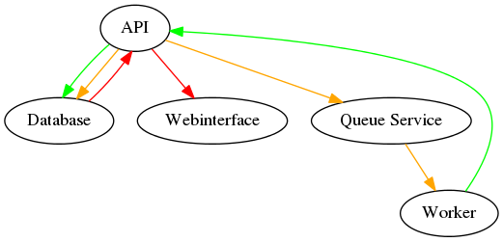
Fractal application on FedCloud
Sample application borrowed from OpenStack “First Application For OpenStack” tutorial*
Compute & display fractals using a set of worker nodes that get the tasks using a queue service
VM1
A single binary includes all services.
Configuration is controllable with command-line parameters
VM2
Worker
*Licensed under Creative Commons Attribution 3.0 License http://creativecommons.org/licenses/by/3.0/legalcode.

Slide 94
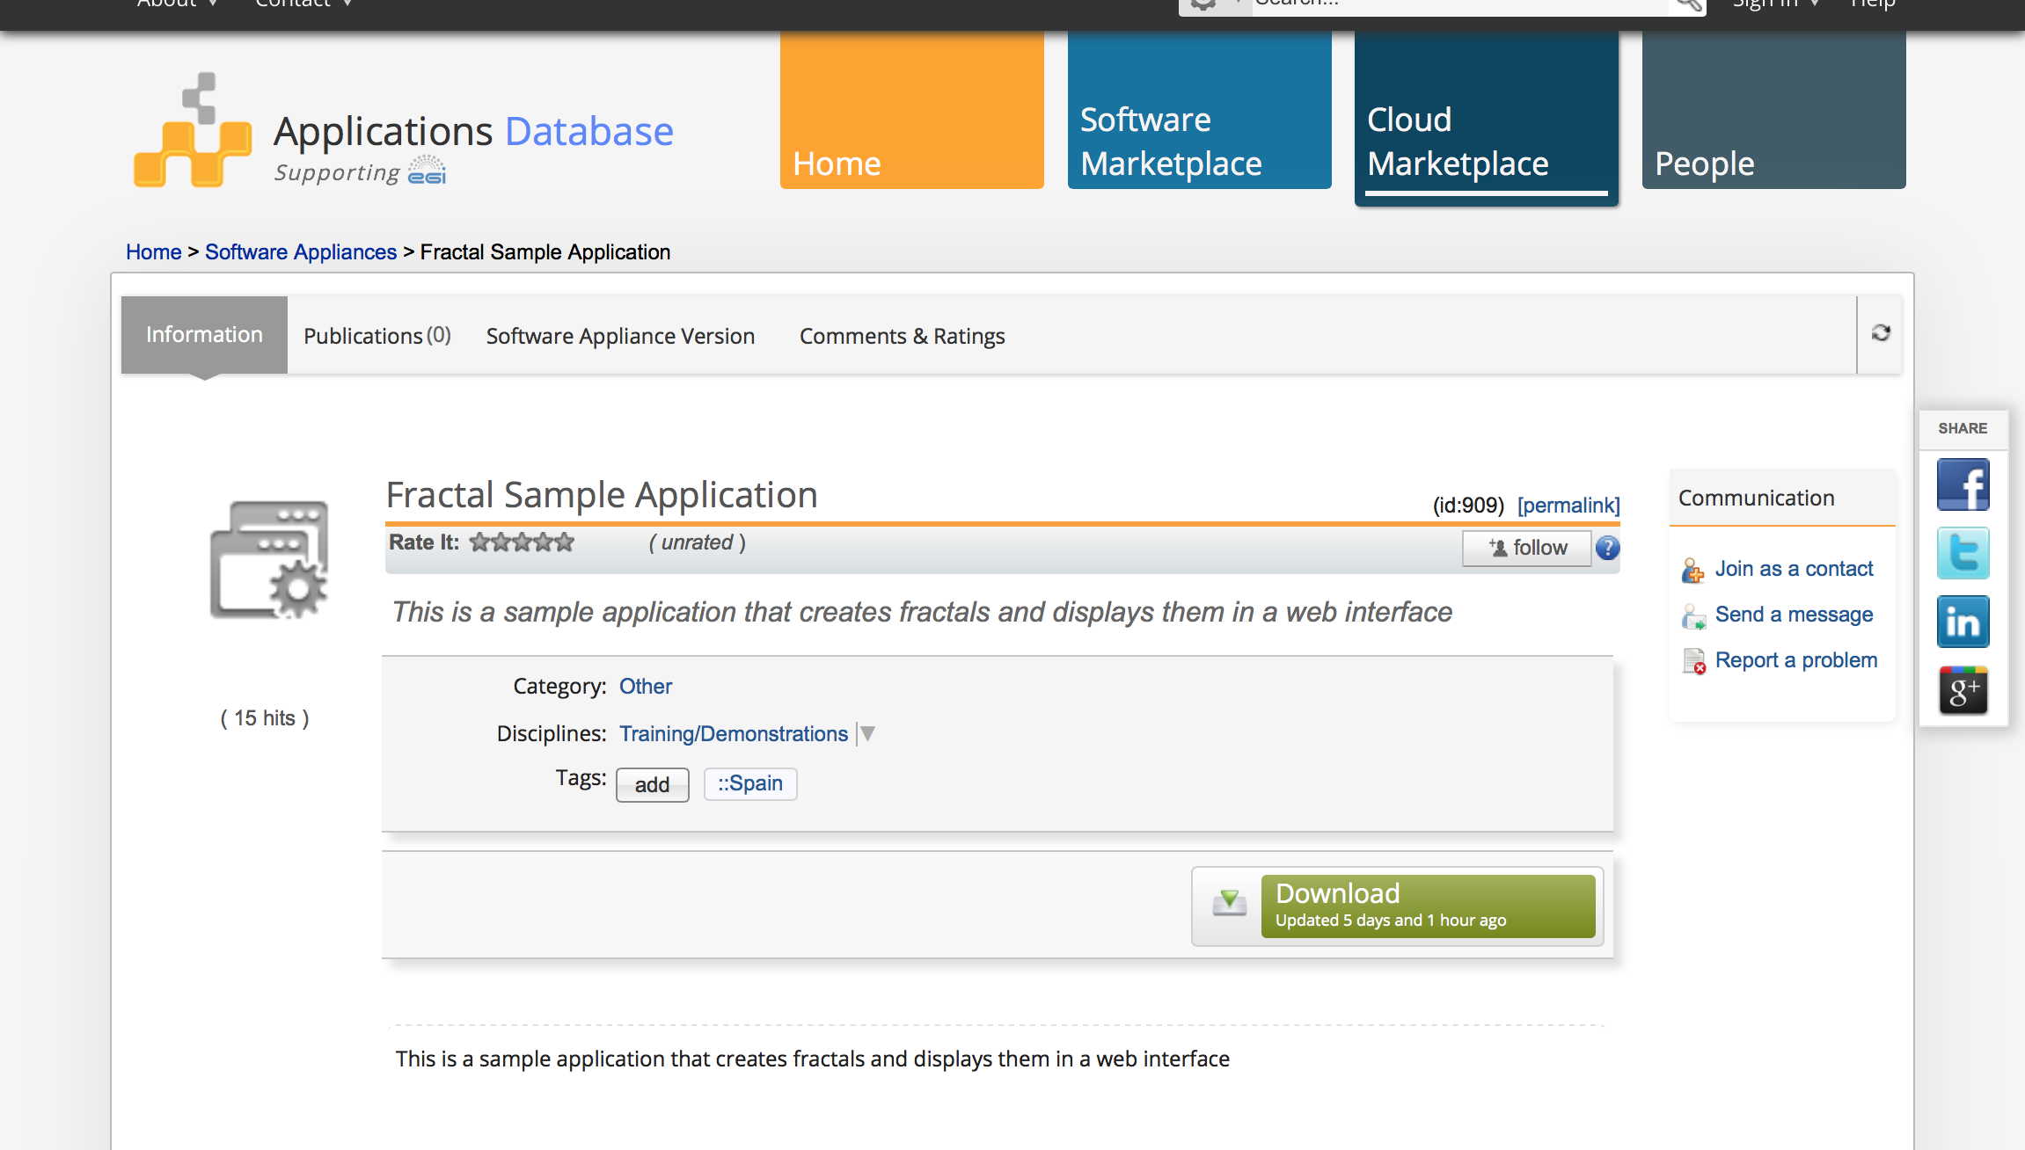
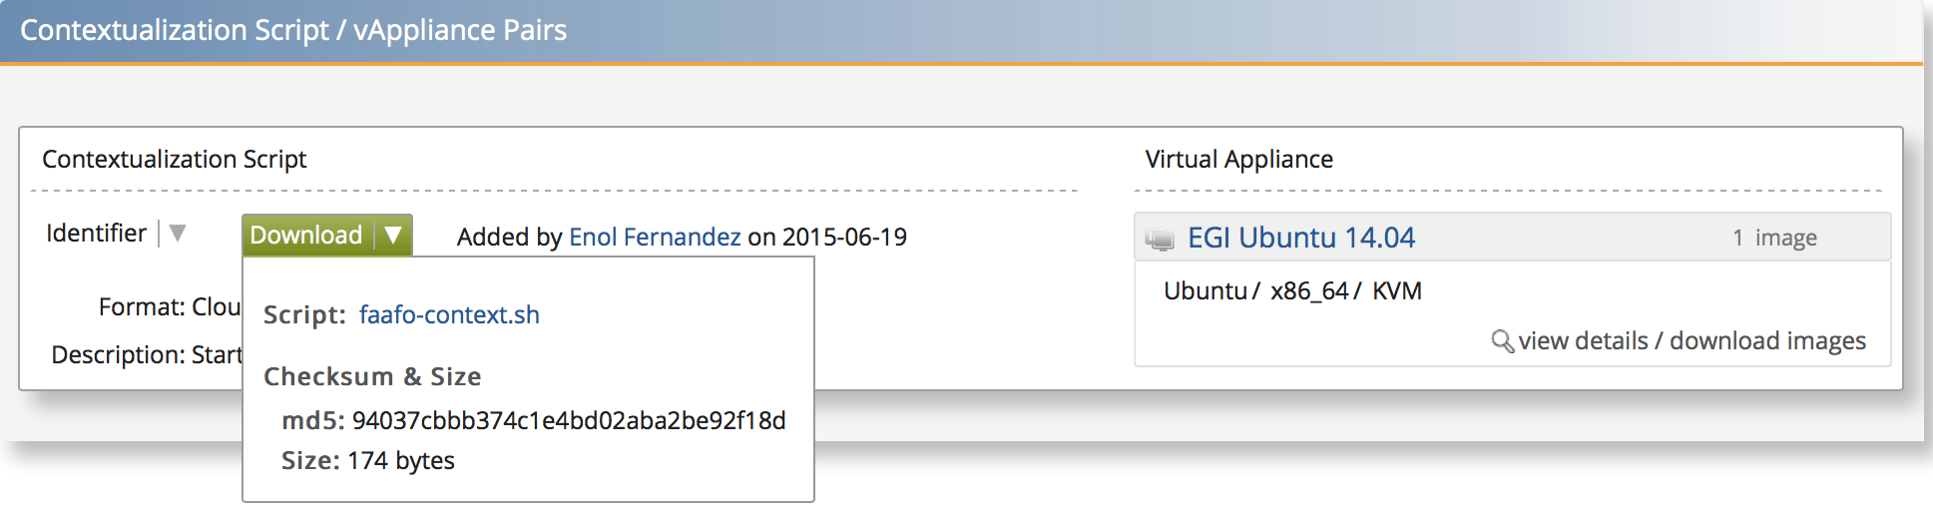
Where to find contextualised VAs? Software Appliances in AppDB
Notes:
SA extends a VA image set with a contextualization script in order to run the images in the set

Slide 95
Workflow
Get the Fractal VA details from AppDB
Download contextualization script from AppDB
Start a VM that holds the complete application, then generate a few fractals → VM1
Modify the contextualization script for a worker
Start a worker VM – it will listen on the queue service → VM2
Create some more fractals
Check that second worker also generated fractals

Slide 96
Start Application
From the Fractal VA
~$ OS_TPL=<OCCI ID from AppDB>
~$ RESOURCE_TPL=<Template ID from AppDB>
~$ curl -k <context script URL from AppDB> > context.sh
~$ occi --endpoint $ENDPOINT \
--auth x509 --voms --user-cred $X509_USER_PROXY \
--action create --resource compute \
--mixin $RESOURCE_TPL --mixin $OS_TPL \
--attribute occi.core.title="fractal$(date +%s)" \
--context user_data="file:///$PWD/context.sh" \
--context public_key="file:///$HOME/.ssh/id_rsa.pub"
~$ MASTER_ID=...
Save the ID in an Env. variable

Slide 97
List and describe your VM instance
~$ occi --endpoint $ENDPOINT \
--auth x509 --voms --user-cred $X509_USER_PROXY \
--action list --resource compute
~$ occi --endpoint $ENDPOINT \
--auth x509 --voms --user-cred $X509_USER_PROXY \
--action describe --resource $MASTER_ID

Slide 98
Accessing the appliance
If the VM does not have a public IP (BIFI endpoint):
~$ occi --endpoint $ENDPOINT \
--auth x509 --voms --user-cred $X509_USER_PROXY \
--action link --resource $MASTER_ID \
--link /network/public
Login with your ssh key and create some fractals:
Check in your browser:
http://<your vm ip>/
~$ faafo --endpoint-url http://localhost --verbose create

Slide 99
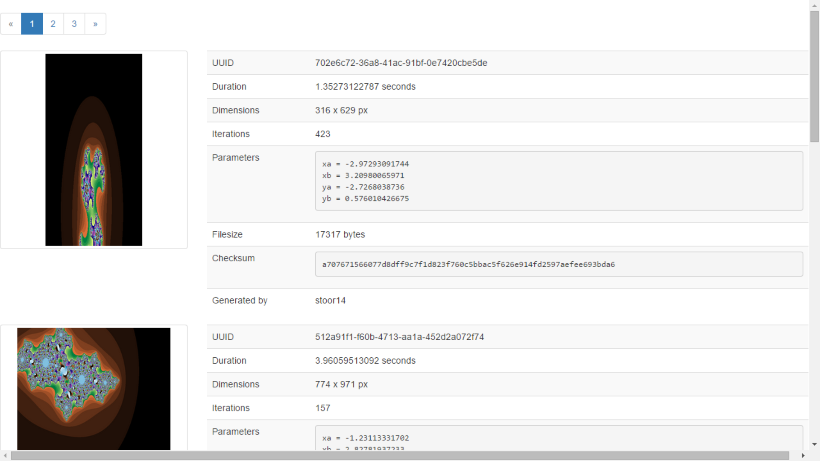

Slide 100
Add workers to the app
Adapt the contextualization script
Start only a worker, not a whole application
Connect the worker to the messaging queue
Create worker.sh with the following content:
#!/usr/bin/env bash
curl -L -s http://git.openstack.org/cgit/stackforge/faafo/plain/contrib/install.sh | bash -s -- \
-i faafo -r worker -e 'http://<VM IP>' -m 'amqp://guest:guest@<VM IP>:5672/'
Use here your previous VM IP

Slide 101
Start Worker – On the same, or on a different cloud site
~$ OS_TPL=<OCCI ID from AppDB>
~$ RESOURCE_TPL=<Template ID from AppDB>
~$ occi --endpoint $ENDPOINT \
--auth x509 --voms --user-cred $X509_USER_PROXY \
--action create --resource compute \
--mixin $RESOURCE_TPL --mixin $OS_TPL \
--attribute occi.core.title="worker$(date +%s)" \
--context user_data="file:///$PWD/worker.sh" \
--context public_key="file:///$HOME/.ssh/id_rsa.pub"
~$ WORKER_ID="..."
Only if different cloud sites are used for Master and Worker

Slide 102
Accessing the appliance
Create some fractals at master VM (Don’t change localhost!)
~fractal $ faafo --endpoint-url http://localhost \
--verbose create --tasks 20
Check in your worker the activity:
~worker $ top
Check in your browser the “creator” of each fractal
TIP: If you want to make sure that the Master gives the task to the second worker then disable the faafo-worker process in the first VM:
Comment out the [faafo-worker] in /etc/supervisor/conf.d/faafo.conf and restart the supervisor: sudo service supervisor restart.
This will make all the fractal generation go to VM2.

Slide 103
Remember to delete your VMs!
~$ occi --endpoint $ENDPOINT \
--auth x509 --voms --user-cred $X509_USER_PROXY \
--action delete --resource $MASTER_ID
~$ occi --endpoint $ENDPOINT \
--auth x509 --voms --user-cred $X509_USER_PROXY \
--action delete --resource $WORKER_ID

Slide 104

Using Docker in the EGI Federated Cloud to start a Galaxy server
Docker intro slides repurposed from http://pointful.github.io/docker-intro

Slide 105
What is Docker ? https://www.docker.com
Containers-As-A-Service platform that allows building and running distributed applications anywhere
This guarantees that your application will always run regardless of the environment it is running on.
When your application is in a Docker containers, you don’t have to worry about setting up and maintaining different environments of different tool for each languages.

Slide 106
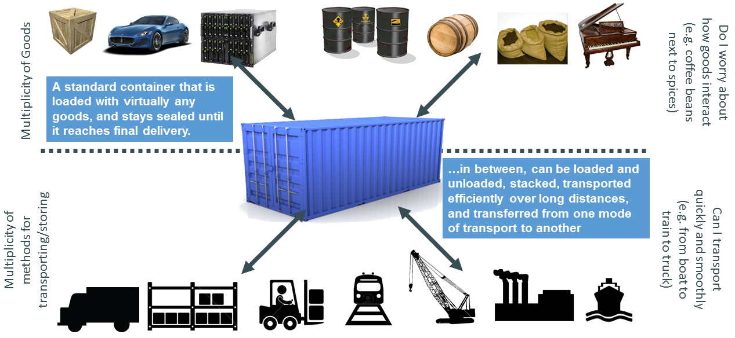
Intermodal shipping container – solution for pre-cargo problem before 1960

Slide 107
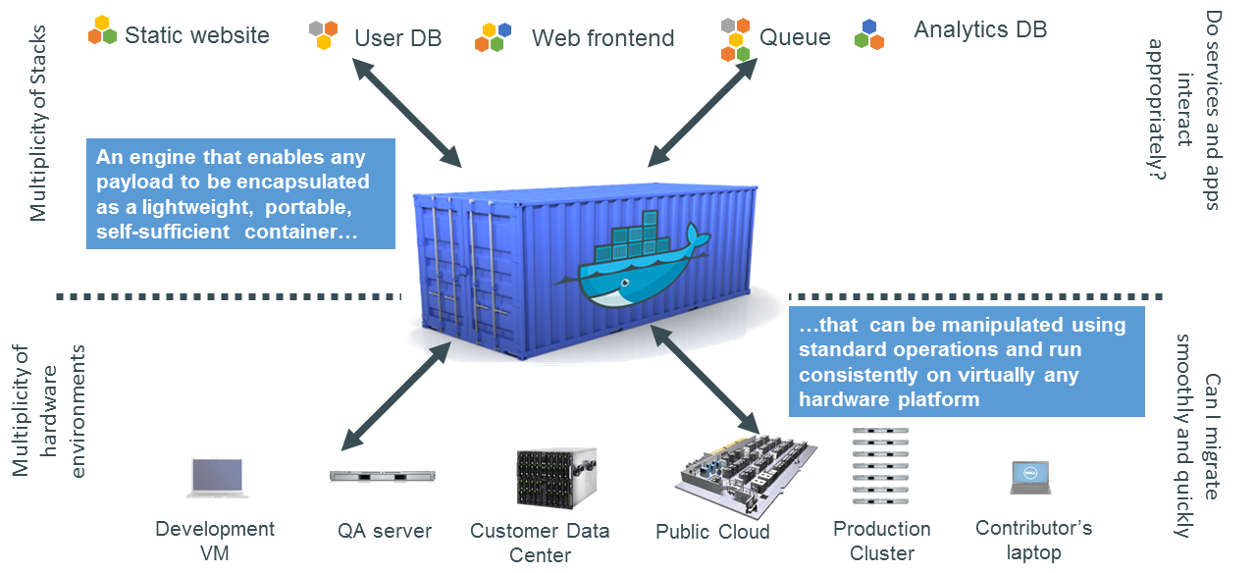
Docker – Container system for code

Slide 108
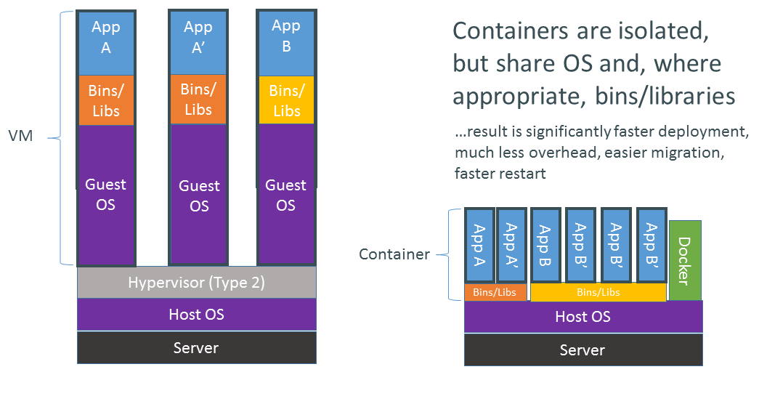
VMs vs containers in the cloud
VM
VM
VM
VM
App A
App A’
App B
Cloud Management Framework
Bins/Libs
Bins/Libs
Cloud host OS
Guest OS
Guest OS
Server
Cloud Management Framework
Cloud host OS
Server

Slide 109
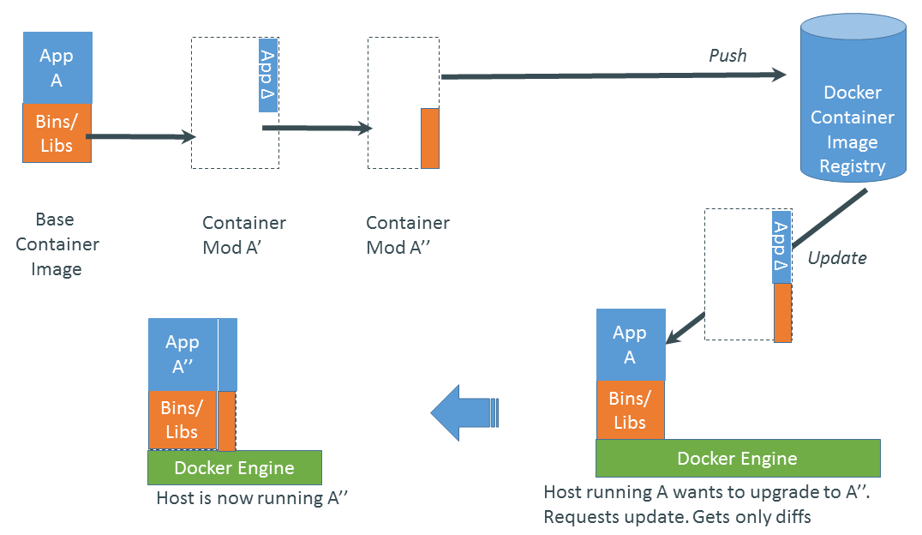
Updates, Changes Why are Docker containers lightweight?
Docker Hub

Slide 110
Exercise #5: Docker and Galaxy
Galaxy is an open, web-based platform for data intensive biomedical research
Becoming a standard for running downstream analysis
There are several “flavours” of Galaxy, depending on the specific needs:
NCBI-BLAST
ChamicalToolBox
Ballaxy
NGS-deepTools
Galaxy ChIP-exo
Galaxy Proteomics
Imaging
Galaxy for metagenomics

Slide 111
Exercise 5: Running Docker Containers in the EGI Federated Cloud
Tasks:
Browsing the EGI AppDB
Find the 3 IDs required to instantiate the [EGI Docker (Ubuntu 14.04)] image on a cloud site.
Login to UI, check proxy, create key
Create your VM instance
(Optional) Some sites may require the allocation of a public IP before you can log in
SSH into your VM instance
Run Docker commands and start a Galaxy server
Delete your VM

Slide 112
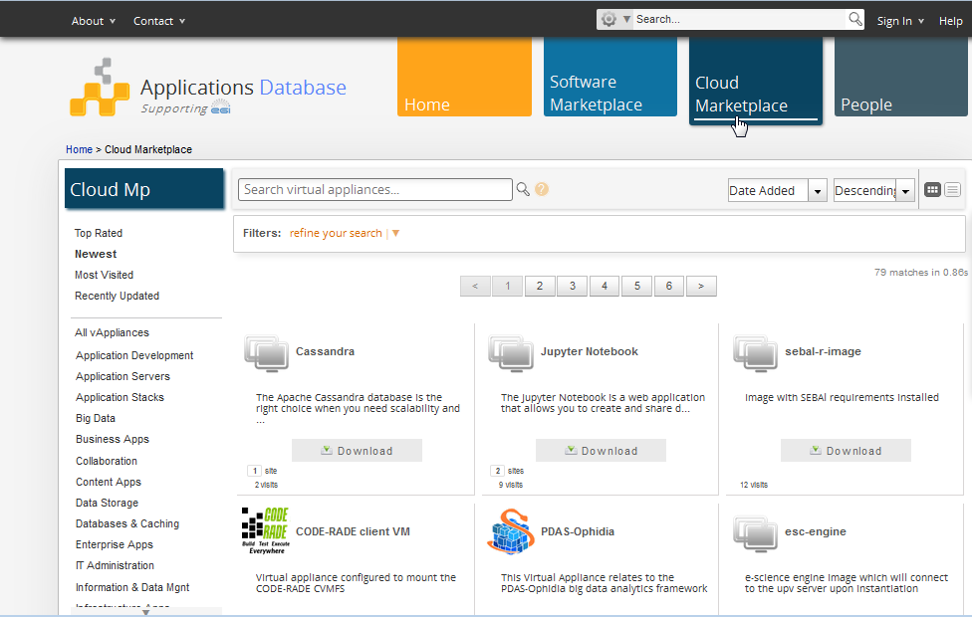
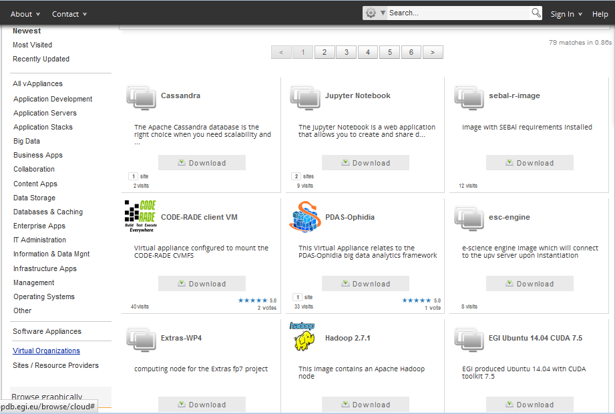
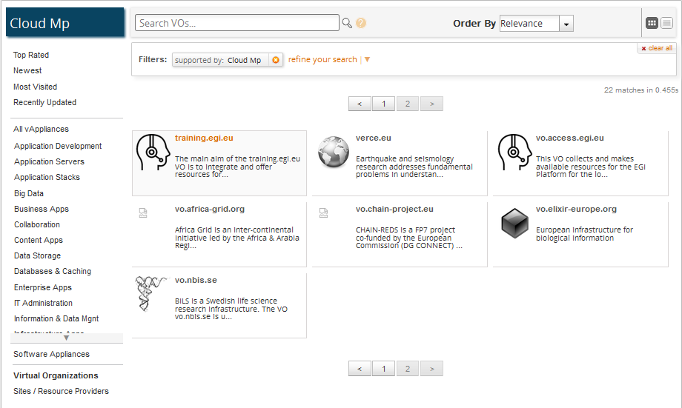
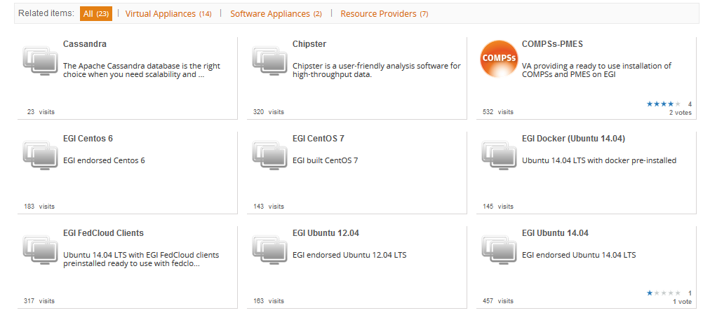
VM with pre-deployed Docker Engine in EGI AppDB

Slide 113
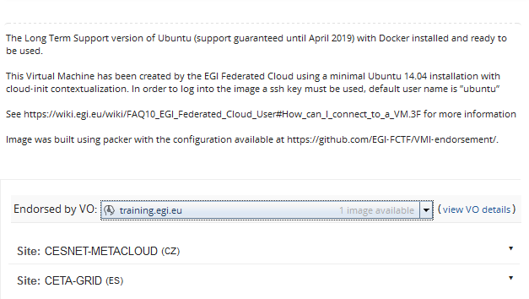
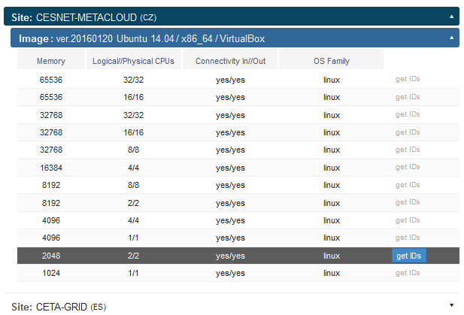
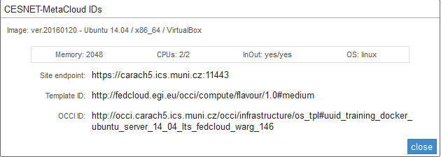
Check the Docker Containers in the EGI AppDB
Which cloud
In which template
Which image

Slide 114
Create your first compute appliance
Use Docker Ubuntu 14.04 VA values from AppDB!
~$ ENDPOINT=<copy here the Site endpoint ID from AppDB>
~$ RESOURCE_TPL=<copy here the Template ID from AppDB>
~$ OS_TPL=<copy here the OCCI ID from AppDB>
~$ occi --endpoint $ENDPOINT \
--auth x509 --voms --user-cred $X509_USER_PROXY \
--action create --resource compute \
--mixin $RESOURCE_TPL --mixin $OS_TPL \
--attribute occi.core.title="docker$(date +%s)" \
--context public_key="file:///$HOME/.ssh/id_rsa.pub"
~$ COMPUTE_ID=...
Save the ID in an ENV. variable

Slide 115
List and describe your VM instances
Listing available VMs
~$ occi --endpoint $ENDPOINT \
--auth x509 --voms \
--user-cred $X509_USER_PROXY \
--action list --resource compute
Describing your VM
~$ occi --endpoint $ENDPOINT \
--auth x509 --voms \
--user-cred $X509_USER_PROXY \
--action describe --resource $COMPUTE_ID
This returns lot of info, including the IP Address of your VM!
occi.networkinterface.address = …
→ It’s not so simple ☹ See next slide!

Slide 116
Adding Public IP (Optional)
If the VM does not have a public IP (e.g. BIFI endpoint) attach a public interface as follows:
~$ occi --endpoint $ENDPOINT \
--auth x509 --voms \
--user-cred $X509_USER_PROXY \
--action link --resource $COMPUTE_ID \
--link /network/public
Obtain the IP address from the output of the describe command.

Slide 117
Logging into the appliance
ssh with ubuntu user:
~$ ssh ubuntu@<your vm ip>

Slide 118
Verify if the Docker is installed properly
ubuntu@stoor196:~$ sudo docker run hello-world
Unable to find image 'hello-world:latest' locally
latest: Pulling from library/hello-world
b901d36b6f2f: Pull complete
0a6ba66e537a: Pull complete
Digest: sha256:8be990ef2aeb16dbcb9271ddfe2610fa6658d13f6dfb8bc72074cc1ca36966a7
Status: Downloaded newer image for hello-world:latest
Hello from Docker.
This message shows that your installation appears to be working correctly.
To generate this message, Docker took the following steps:
1. The Docker client contacted the Docker daemon.
2. The Docker daemon pulled the "hello-world" image from the Docker Hub.
3. The Docker daemon created a new container from that image which runs the
executable that produces the output you are currently reading.
4. The Docker daemon streamed that output to the Docker client, which sent it
to your terminal.
To try something more ambitious, you can run an Ubuntu container with:
$ sudo docker run -it ubuntu bash
Share images, automate workflows, and more with a free Docker Hub account:
https://hub.docker.com
For more examples and ideas, visit:
https://docs.docker.com/userguide/

Slide 119
Start the Galaxy server
After connecting to the newly launched VM, start the Galaxy docker instance as follows:
We also need to clean-up any “orphan” volumes
Galaxy starts a web-server (by default listening to port 8080)
Go to your web-browser and type:
http://[public ip]:8080
~$ sudo docker run -d -p 8080:80 -p 8021:21 bgruening/galaxy-stable
~$ sudo docker volume rm $(sudo docker volume ls -qf dangling=true)

Slide 120
Persistent storage vs Read-only
By default, the Docker Galaxy image is read-only.
All changes inside one session will be lost after restart.
This mode is useful to present Galaxy to your colleagues or to run workshops with it.
To install Tool Shed repositories or to save your data you need to create a persistent storage volume

Slide 121
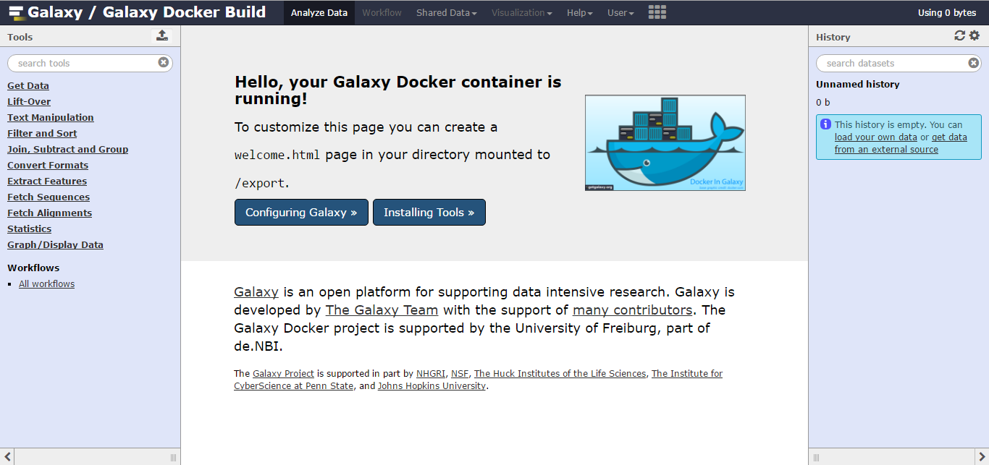
Galaxy main interface
You can create your own user
For admin rights, the Galaxy Admin User has the username admin@galaxy.org and the password admin.

Slide 122
Install new tool: “join”
As “admin” open the Admin section, and go to “Search Tool shed”
Search for the “join” tool
Preview and install
After accepting the default setting for all aspects (i.e. dependencies, etc), you will be able to see the new tool on the list
We need to restart the container in order for the tool to be installed correctly
~$ sudo docker ps –a
~$ sudo docker stop <containerID>
~$ sudo docker start <containerID>

Slide 123
A simple Galaxy exercise
Goal: Find the chr22 exons with the highest number of SNPs
Get coding exons
obtain data from UCSC by clicking Get Data -> UCSC Main
Keep the default setting in the Table Browser, with the exception of position (chr22) and assembly (hg19)
In the next screen, select “Coding Exons” and send the query to Galaxy
The main screen of the Galaxy will now show the newly created step as a new entry in the history (right column)
Modified exercise from Galaxy 101: https://github.com/nekrut/galaxy/wiki/Galaxy101-1

Slide 124
A simple Galaxy exercise
Get the SNPs;
Same process, but this time select “Variation” in the “group” setting
We can rename the history items, to better reflect our process (“Exons” and “SNPs” respectively)
Let’s join the two datasets. However, we need the tool we installed in the first step
Go to “Join, Subtract and Group” (or the group you assigned the new tool to), and run the “join” tool

Slide 125
A simple Galaxy exercise
Next step would be to count the number of SNPs per exon
“Join, Subtract, and Group” -> “Group” tool
Use Column 4 as the grouping attribute
Insert a new operation “Count” on the same column
In order to identify the exon with the highest number of SNPs, we need to “sort” and “filter” the new dataset
“Filter and Sort” -> “Sort” (on Column 2)
“Text Manipulation” -> “Select First” (set top 10)

Slide 126
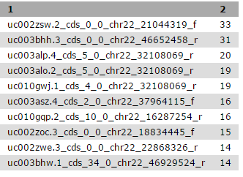
A simple Galaxy exercise
The final table should look like this:
We have identified the top exons, but with little information yet.
Let’s combine this, with the original Exon data

Slide 127
A simple Galaxy exercise
“Join, Subtract and Group” -> “Compare two Queries” tool
1: Exons dataset, using column #4
2. Last dataset, using column #1
The best way to learn about these exons is to look at their genomic surrounding.
There is really no better way to do this than using genome browsers.
Because this analysis was performed on "standard" human genome (hg38 in this case), you have two choices
UCSC Genome Browser, and
IGV

Slide 128
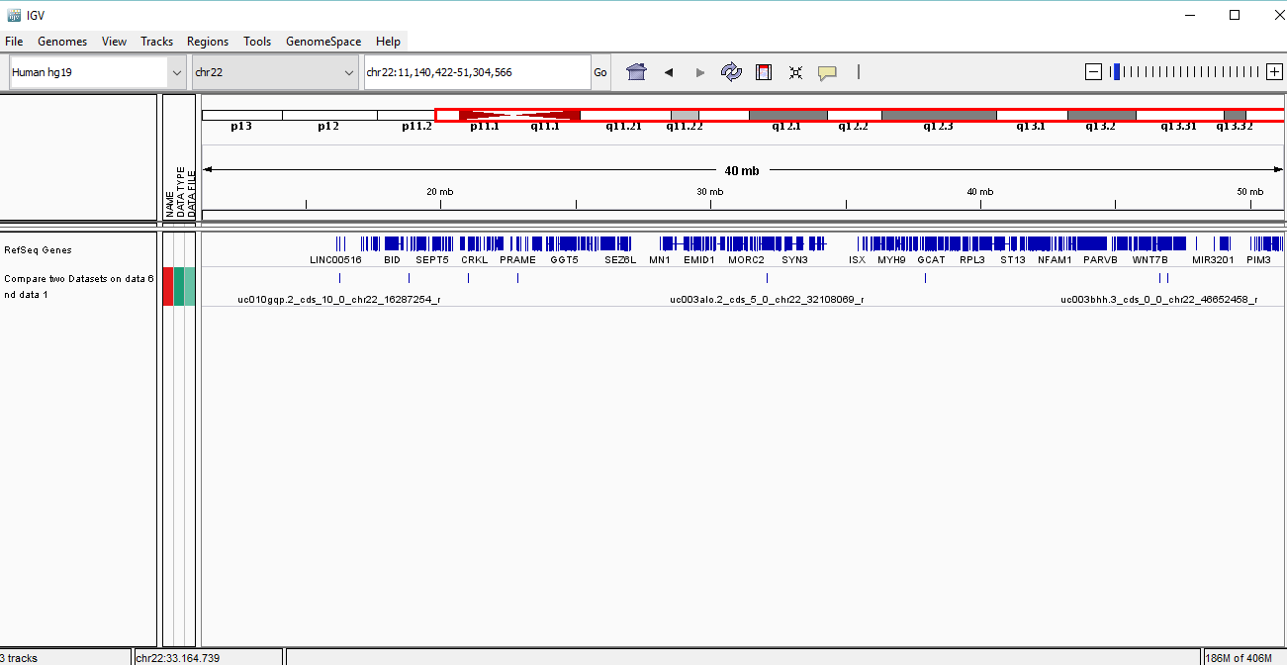
A simple Galaxy exercise

Slide 129
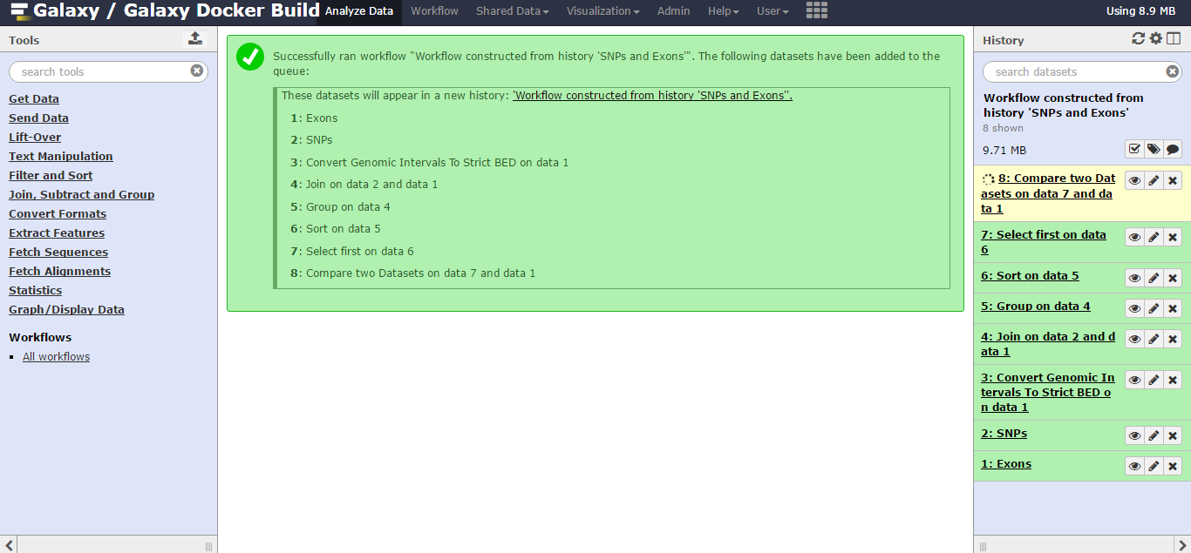
A simple Galaxy exercise
Finally, you can rename and save your entire workflow for use in the future (or other training sessions)

Slide 130
Stop the service
We can stop the service using the following docker command
Where the id can be identified with the command:
~$ sudo docker stop <id>
~$ sudo docker ps -a

Slide 131
Clean up and stop the VM
Delete the VM:
~$ occi --endpoint $ENDPOINT \
--auth x509 --voms \
--user-cred $X509_USER_PROXY \
--action delete --resource $COMPUTE_ID

Slide 132
Preparing your own VM image

Slide 133
Image Creation
Create VM with some virtualization software:
VirtualBox (available for most OS, easy to use)
KVM
Xen
VMWare
…
Once VM is configured as needed, export to the proper format
OVF is the preferred format in the EGI Federated Cloud

Slide 134
Image containers and disk images
A VM is a set of disk images within a container (Docker)
Normally one disk image per VM
Disk images: contain the actual disk for the VM
raw: a direct copy of the disk into a file
qcow2: copy-on-write format that allows fast duplication of images
VMDK: sparse file format created by VMWare, now open format
…
Containers: package the disks + metadata
raw: no container, just the disk image
OVF (Open Virtualization Format): open format by the Distributed Management Task Force (DMTF)
…

Slide 135
OVF, OVA and VMDK
OVF is a specification for packaging and distributing software appliances
An OVF package consists of:
OVF description (XML file with .ovf extension) that contains the metadata (name, hardware requirements, etc.)
One or more disk images: any format can be used, but in practice every implementation uses VMDK
Optional auxiliary files (certificates, checksums, …)
An OVA (OVF archive) is a tar file of a OVF package
Easier for distribution than a directory with the files

Slide 136
Packer
Packer is a tool for creating machine and container images for multiple platforms from a single source configuration
Reproducible builds
Creates VM in your virtualization platform (or cloud)
Executes scripts on top to install/configure
Can apply the same scripts to different platforms (so all images are the same at the end)

Slide 137
Packer Image Template
JSON file containing the description of what to build.
Builders
Define how to install/start the VM for a given platform
Supports AWS, OpenStack, VirtualBox, qemu, VMWare, …
Provisioners
Define how to install and configure software into the image
Several types: shell scripts, uploading files, puppet, chef, ansible, …

Slide 138
Packer builder
"builders": [{
"type": "virtualbox-iso",
"guest_os_type": "Ubuntu_64",
"disk_size": 2000,
"iso_url": "http://archive.ubuntu.com/ubuntu/dists/trusty/main/installer-amd64/current/images/netboot/mini.iso",
"iso_checksum": "bc09966b54f91f62c3c41fc14b76f2baa4cce48595ce22e8c9f24ab21ac8d965",
"iso_checksum_type": "sha256",
"ssh_username": "root",
"ssh_password": "rootpasswd",
"ssh_wait_timeout": "90m",
"shutdown_command": "shutdown -h now",
"http_directory": "httpdir",
"http_port_min": 8500,
"http_port_max": 8550,
"boot_command": [
"<esc>",
" install auto=true priority=critical preseed/url=http://{{ .HTTPIP }}:{{ .HTTPPort }}/ubuntu.cfg",
"<enter>"
],
"vm_name": "Ubuntu.14.04.20150623"
}],
Notes:
This is an example for building a Ubuntu 14 image using virtual box. Interesting things are:
disk_size: 2GB for the resulting image
Iso_url: this will be downloaded to start installation
Boot command: the instructions to start the installation, the ubuntu.cfg file (available in EGI-FCTF/VMI-Endorsement repo) specifies the steps for the installation

Slide 139
Packer provisioners
"provisioners": [
{
"type": "file",
"source": "provisioners/cloud.cfg",
"destination": "/root/cloud.cfg"
},
{
"type": "file",
"source": "provisioners/sshd_config",
"destination": "/root/sshd_config"
},
{
"type": "shell",
"script": "provisioners/script.sh"
}
]
Notes:
Two types used here: file is copyin a file into the VM and shell is executing a script in the VM, the script can be anything, next slide shows an example

Slide 140
Provisioner: script
#!/usr/bin/env bash
# update already installed packages
apt-get update
if [ "x$(lsb_release -rs)" == "x12.04" ]; then
apt-get --assume-yes install python-software-properties
add-apt-repository -y ppa:iweb-openstack/cloud-init
fi
apt-get update
apt-get --assume-yes upgrade
apt-get --assume-yes install cloud-init curl
# move configuration files to their right place
mv /root/sshd_config /etc/ssh/sshd_config
mv /root/cloud.cfg /etc/cloud/cloud.cfg
ln -s /dev/null /etc/udev/rules.d/75-persistent-net-generator.rules
# remove ssh keys
rm -f /etc/ssh/ssh_host_*
# lock root password
passwd -l root
# clean bash history and cloud init logs
rm -f ~/.bash_history
rm -f /var/log/cloud-init*
# Remove virtualbox things
rm -f VBoxGuestAdditions.iso
Notes:
Sample provisioner script, I think comments are enough to explain what’s going on
This is what is used in the demo video

Slide 141
EGI Endorsed VM images
EGI prepares and provides a few basic VAs for VOs to use
Preparation process assures that these are always well-configured, secure and up-to-date
These have ‘EGI’ in their title in AppDB!
Ask your VO Manager to add these to the VO-wide list!
Guideline to prepare your own image:
https://indico.egi.eu/indico/event/2544/session/46/contribution/32

Slide 142
Make your VM available via AppDB
Package the OVF + disk into OVA
https://github.com/EGI-FCTF/VMI-endorsement/blob/master/tools/ovf2ova.sh
Upload the image to a repository
http://appliance-repo.egi.eu/images/ is available if you need
Register image in AppDB
Create a VA entry https://wiki.appdb.egi.eu/main:faq:how_to_register_a_virtual_appliance
Create a new version within the VA and point to your image location https://wiki.appdb.egi.eu/main:guides:guide_for_managing_virtual_appliance_versions_using_the_portal
Request VA endorsement in your VO (so VMI gets distributed to the cloud sites)
Endorsement requests are dealt with by designated VO members https://wiki.appdb.egi.eu/main:guides:notify_virtual_organization_representatives
VO Manager needs to include your VM in the VO-wide image list. This triggers replication of your image to the clouds of your VO.

Slide 143
Which approach to follow?
Contextualization
Docker
Custom Images
Fast to use, just add user data to VM
Configuration on creation
Slow start-up of VM
Works on top of existing images
Hard to debug if fails
Medium complexity. Needs Docker Engine
Configuration on creation
Fast VM start-up, separate application start-up
Works on Docker-enabled images
Debug in local environment
Time consuming, needs virtualization software
Static configuration
Fast start-up of VM
Requires moving large files to sites
Easier to debug
EGI.eu maintains core VM images in AppDB.
These can be used as starting point in all three scenarios.

Slide 144
Keep in mind!
You have root access to your virtual machines
Your virtual machines are often visible from the Internet
It is up to you to keep your virtual machines updated and secure
DO NOT USE password-based authentication for remote access
You should terminate your virtual machine as soon as it is not needed anymore

Slide 145
Next steps

Slide 146
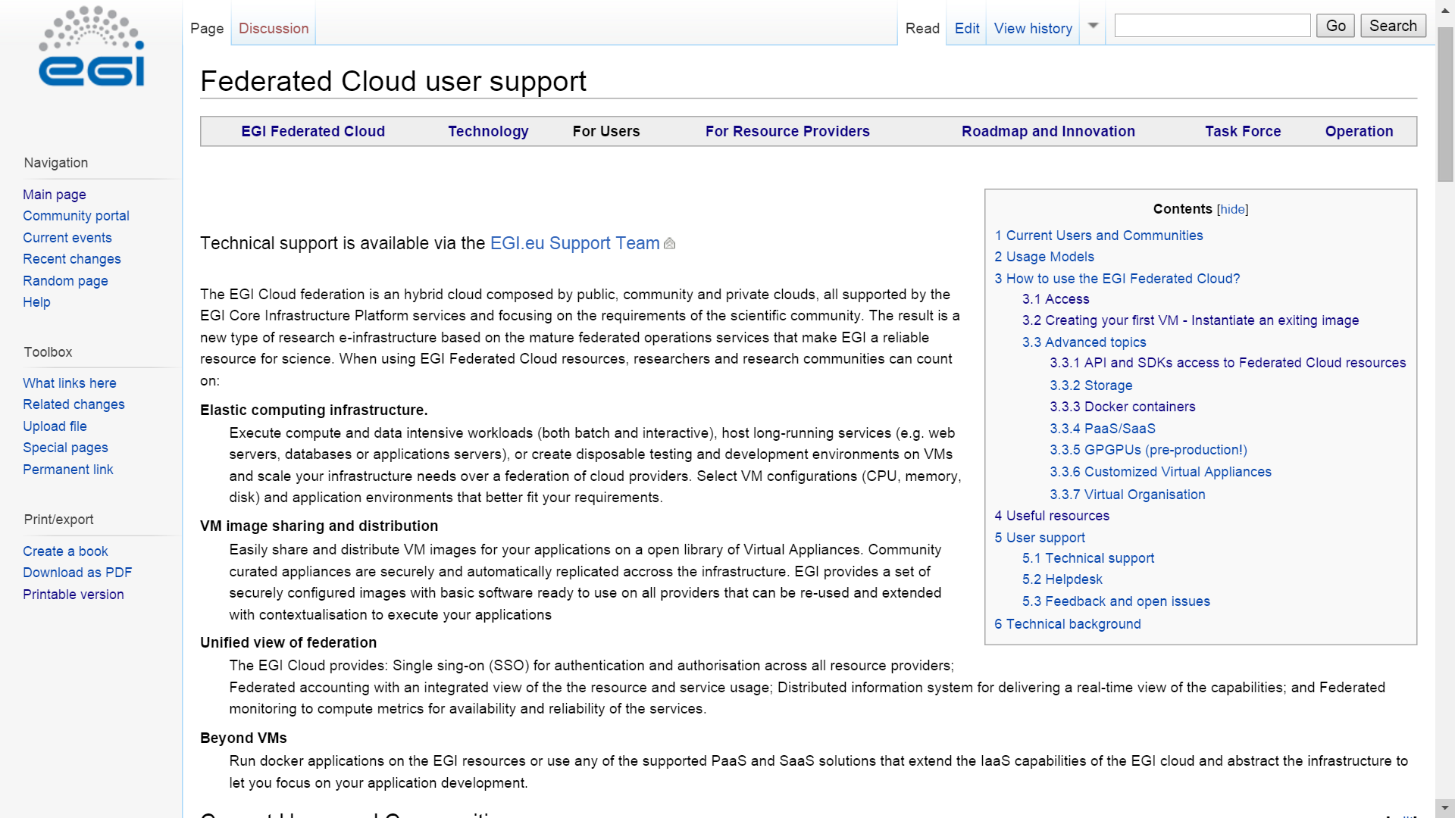
Main resource
EGI Federated Cloud Documentations and Guides:
https://wiki.egi.eu/wiki/Federated_Cloud_user_support

Slide 147
Getting access to the FedCloud
Your steplist:
Obtain certificate from
National CA (face-to-face identity check) http://www.igtf.net
OR
Terena Certificate Service: (online) https://www.digicert.com/sso
Register at the VO
fedcloud.egi.eu is a good starting point
Other VOs: http://operations-portal.egi.eu/vo/search
VO manager authorizes You
Membership DB updated
Identity replicated to resource within 1 day
Interact with the resorurces
rOCCI
API
High-level tool
Obtain certificate: Once Renew certificate: Annually
You
CA
Join VO: Once
VIRTUAL ORGANISATION
Use resources
VO manager
Register
Membership service
User database
Cloud sites
DB replication (once a day)

Slide 148
Support services
Dedicated technical consultancy for any user or community:
support@egi.eu
F2F/Web Meetings
Identify suitable setup
Technical integration
Continuous tracking and support
Periodic meetings
Fedcloud.egi.eu VO
Resources for prototyping
Allocate technical experts
Define milestones
Usable for 2x6 months
Enabled on all sites
Doc
Step by step guides
Secure, up-to-date
Migration to production
Identifying committed resource providers
EGI VM Images
Contextualisation
Examples
Tutorials – CMD line, API
Main OS versions
Support for VO setup
SLAs, OLAs
Docker

Slide 149
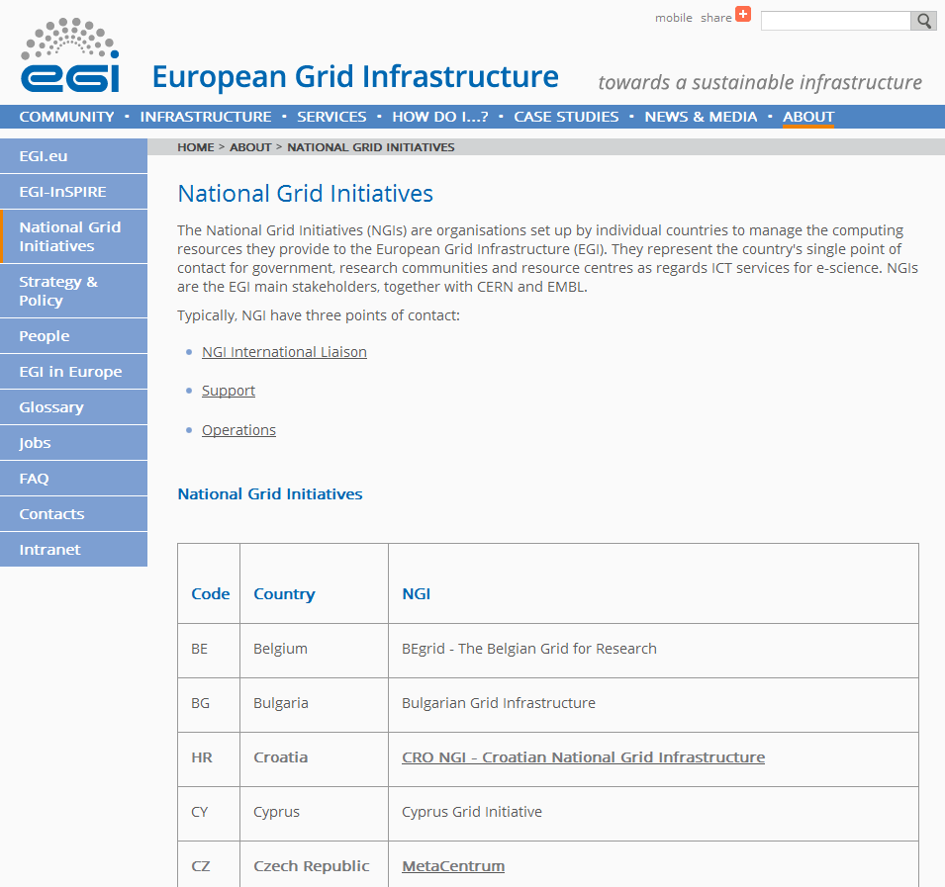
Support through the NGIs
http://www.egi.eu/about/ngis/
EGI’s federated support model
National support teams (NGIs)
Topic/discipline-specific support teams (see next slide)
EGI.eu UCST – primarily coordination & support for supporters (support@egi.eu)
To use resources
To federate resources

Slide 150
Organise a training event
You can book the EGI training infrastructure for your tutorials:
https://wiki.egi.eu/wiki/Training_infrastructure
Please email support@egi.eu specifying training course details :
date, number of students, kind of audiance, special needs, etc.

Slide 151

DI4R 2016 Conference Digital Infrastructures for Research
Krakow, Poland
2016, September 28-30.
Co-organised by EGI, EUDAT, GEANT, OpenAIRE and RDA Europe
Call for participation (deadline 3 June!)
http://www.digitalinfrastructures.eu/

Slide 152
PLEASE RETURN THE FEEDBACK FORMS!

